Slide 1
NSS herring - First XSAM assessment 2019
Sindre Vatnehol et al.

Slide 2
Data input
Same but updatet input data as the final assessment in 2018:
Catch at age
Fleet 1: acoustic surveys on the spawning grounds in February-March.
Fleet 4: immature herring in the Barents Sea in May/June from IESNS.
Fleet 5: international acoustic survey on the feeding areas in the Norwegian Sea in May (IESNS).
Updated covariance matrix for Fleet data.
Due to an upgrade in the bootstrap in StoX

Slide 3
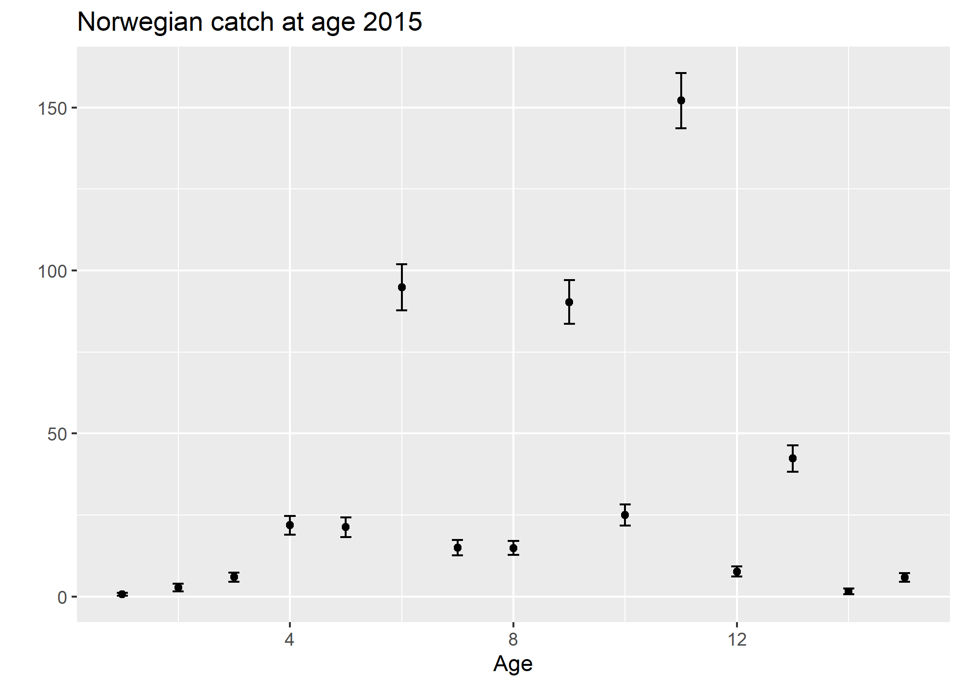
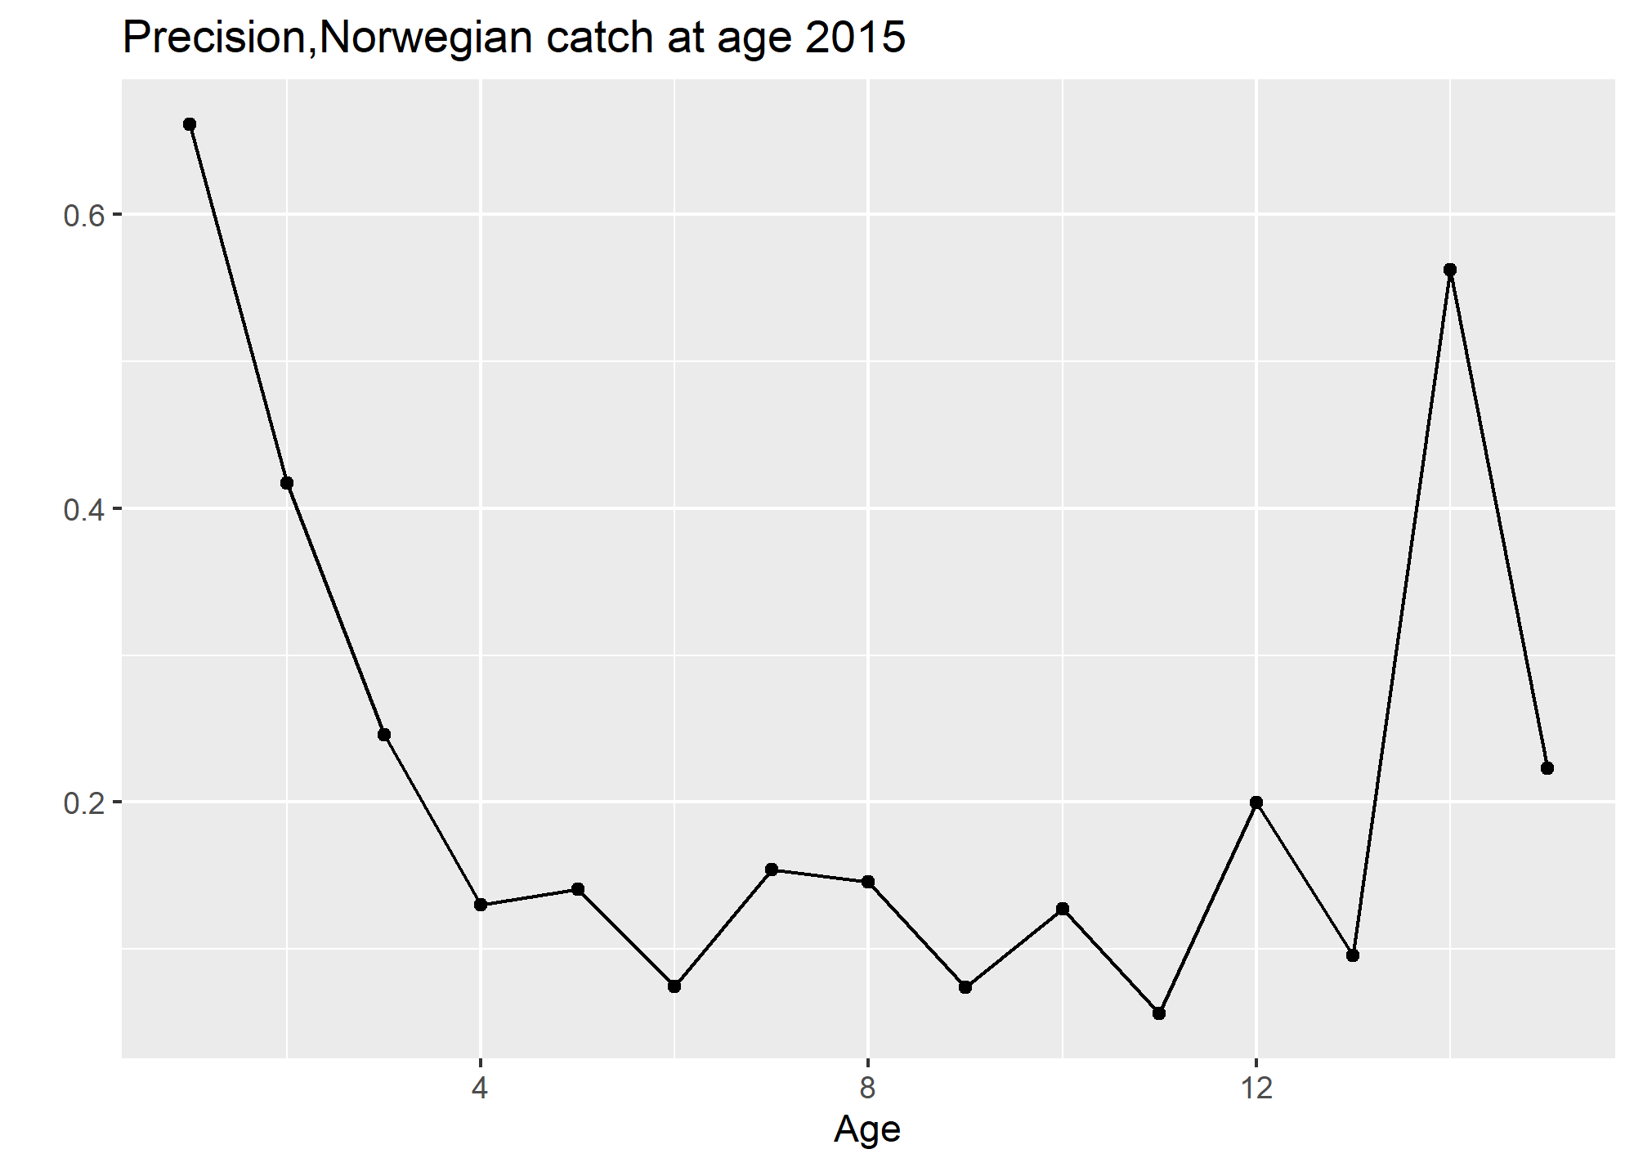
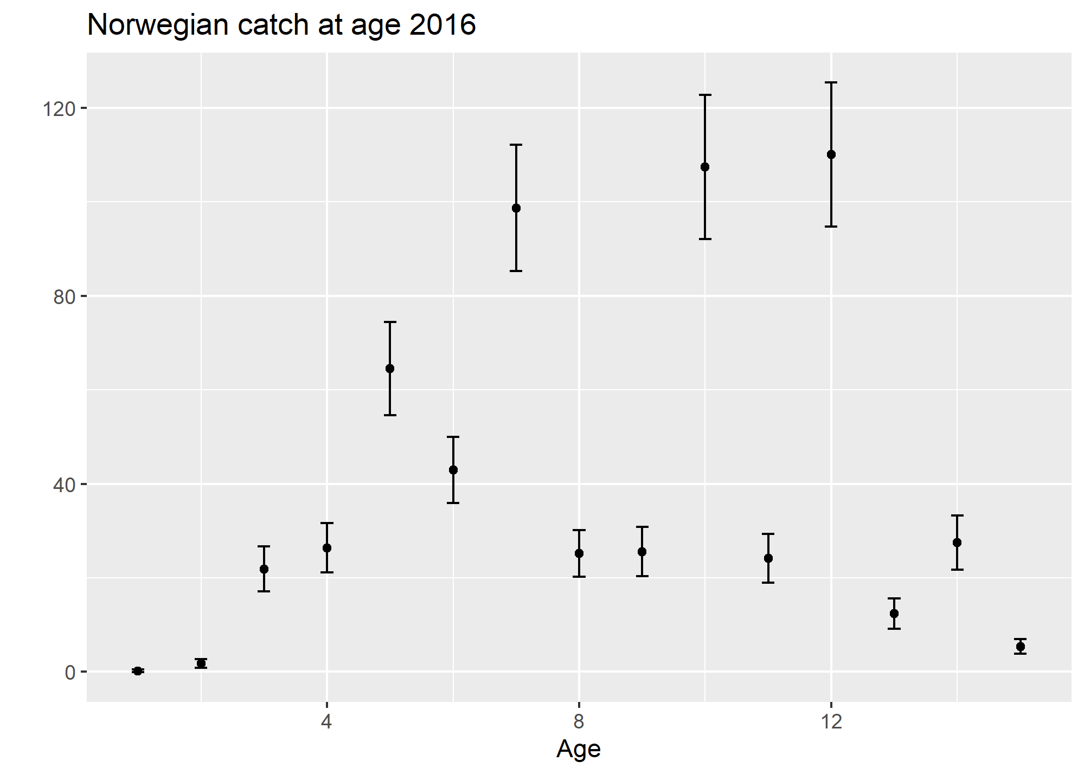
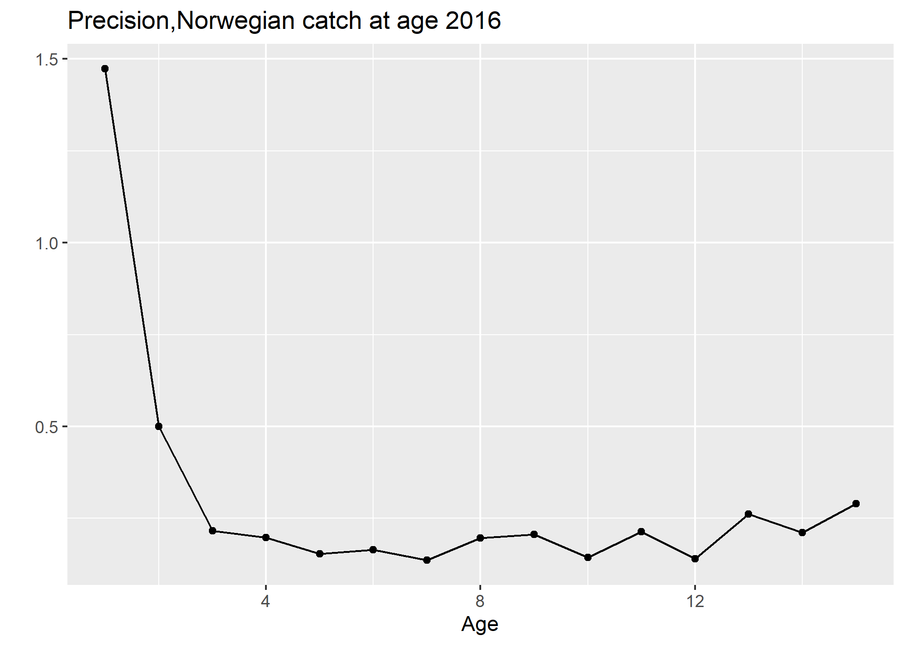
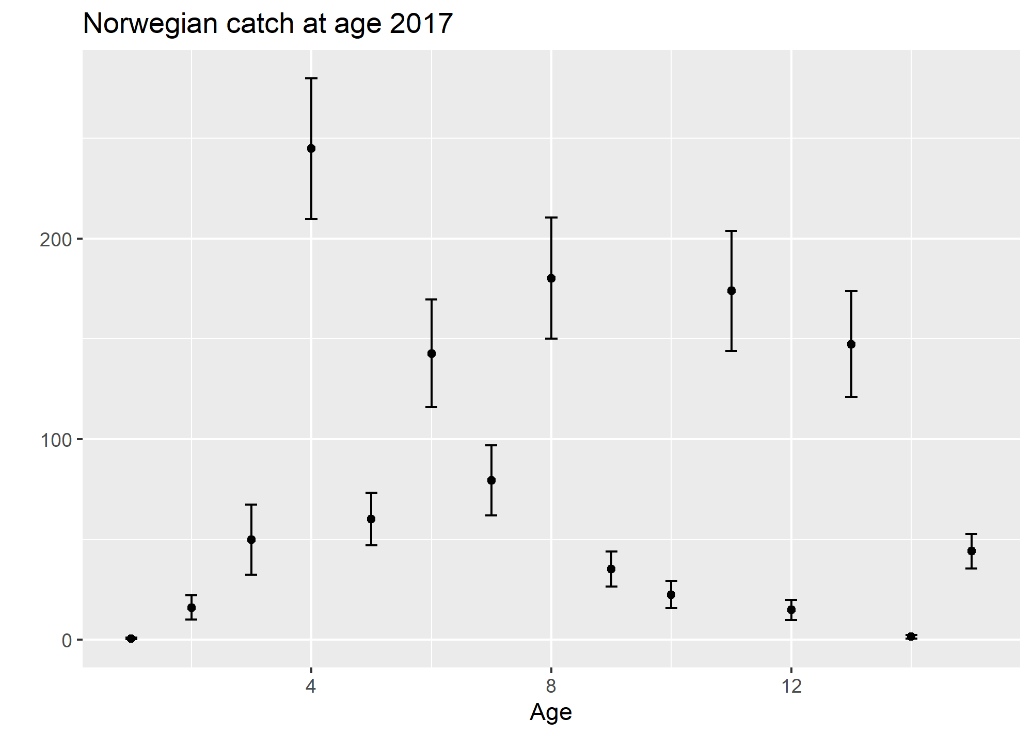
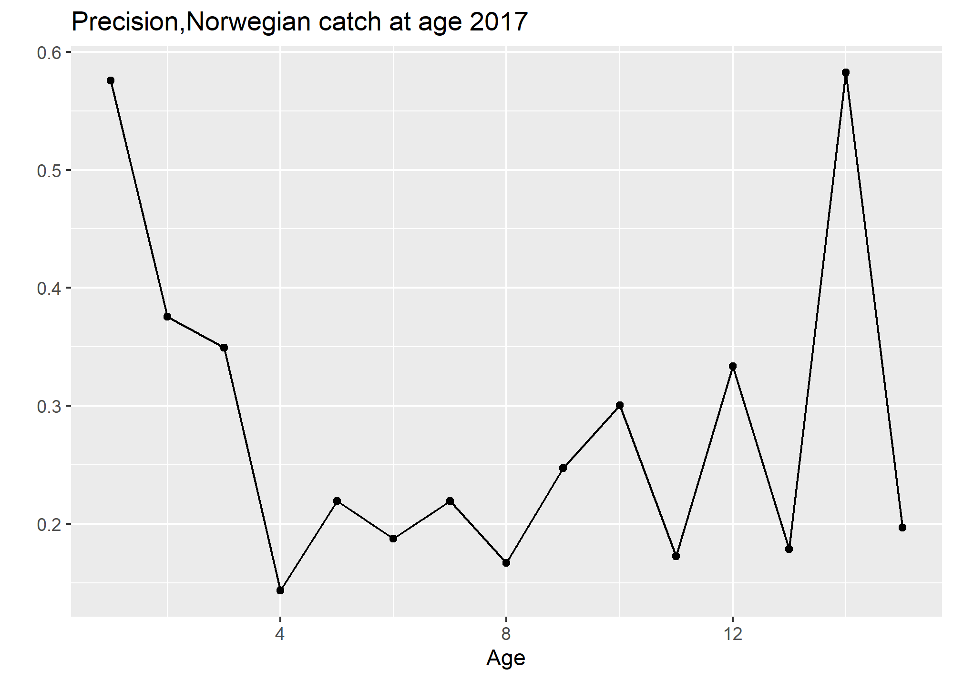
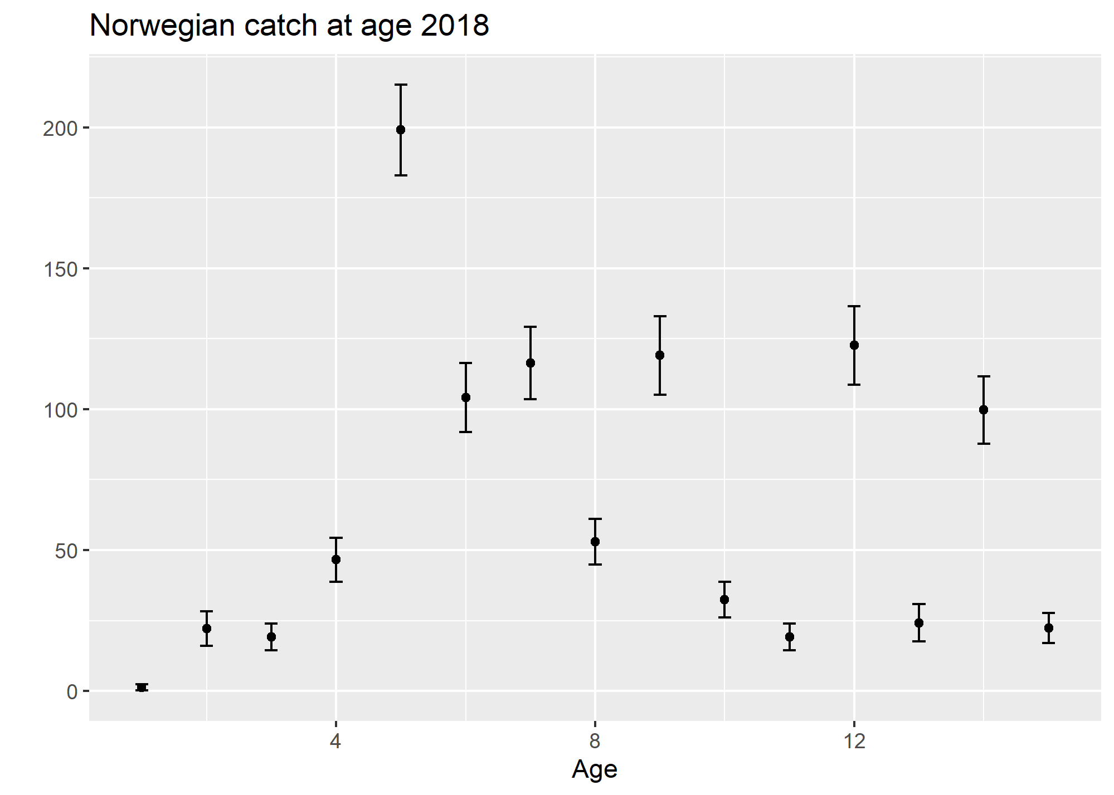
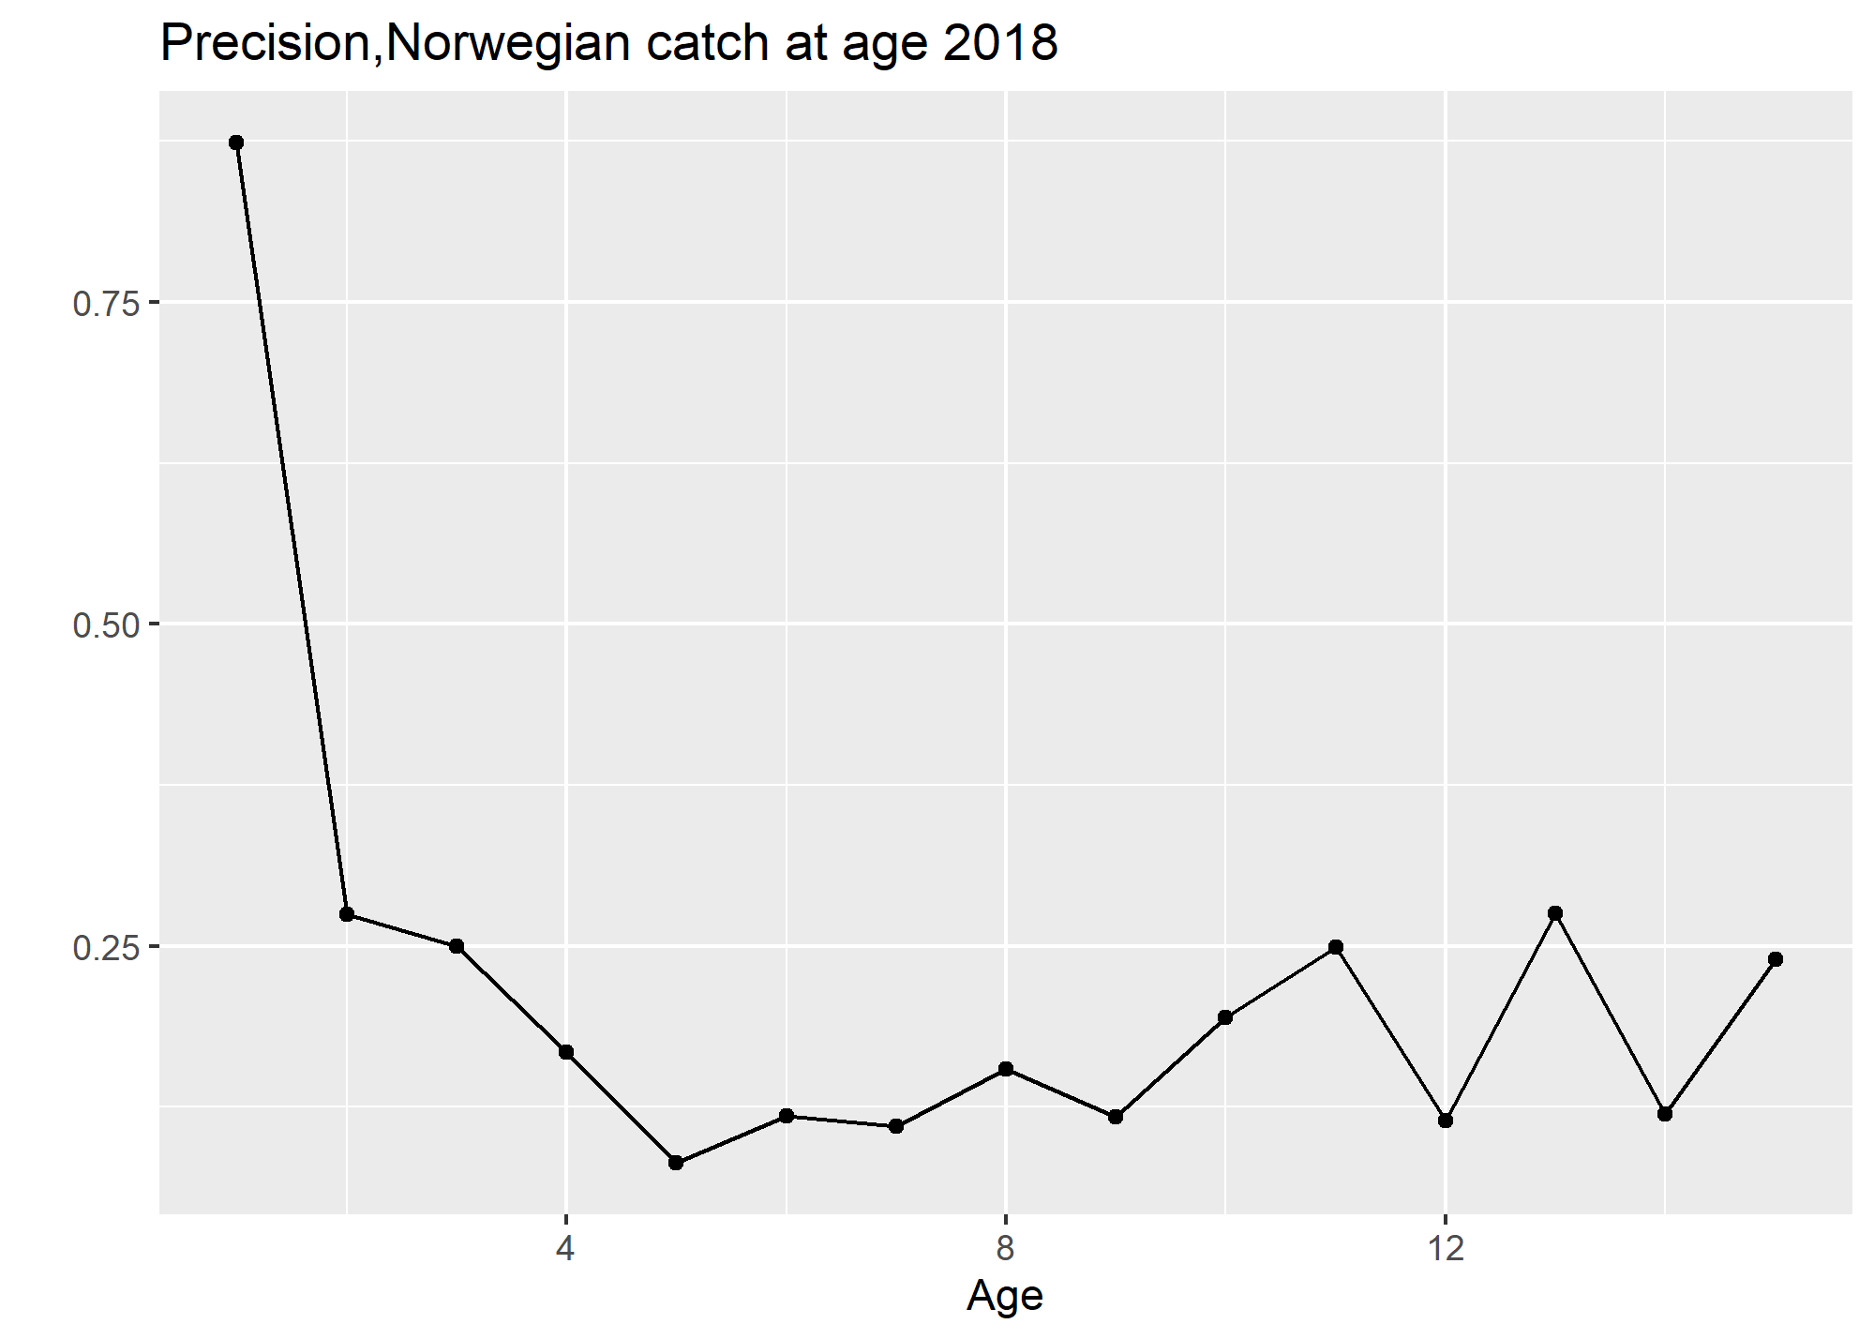
Data Precision

Slide 4
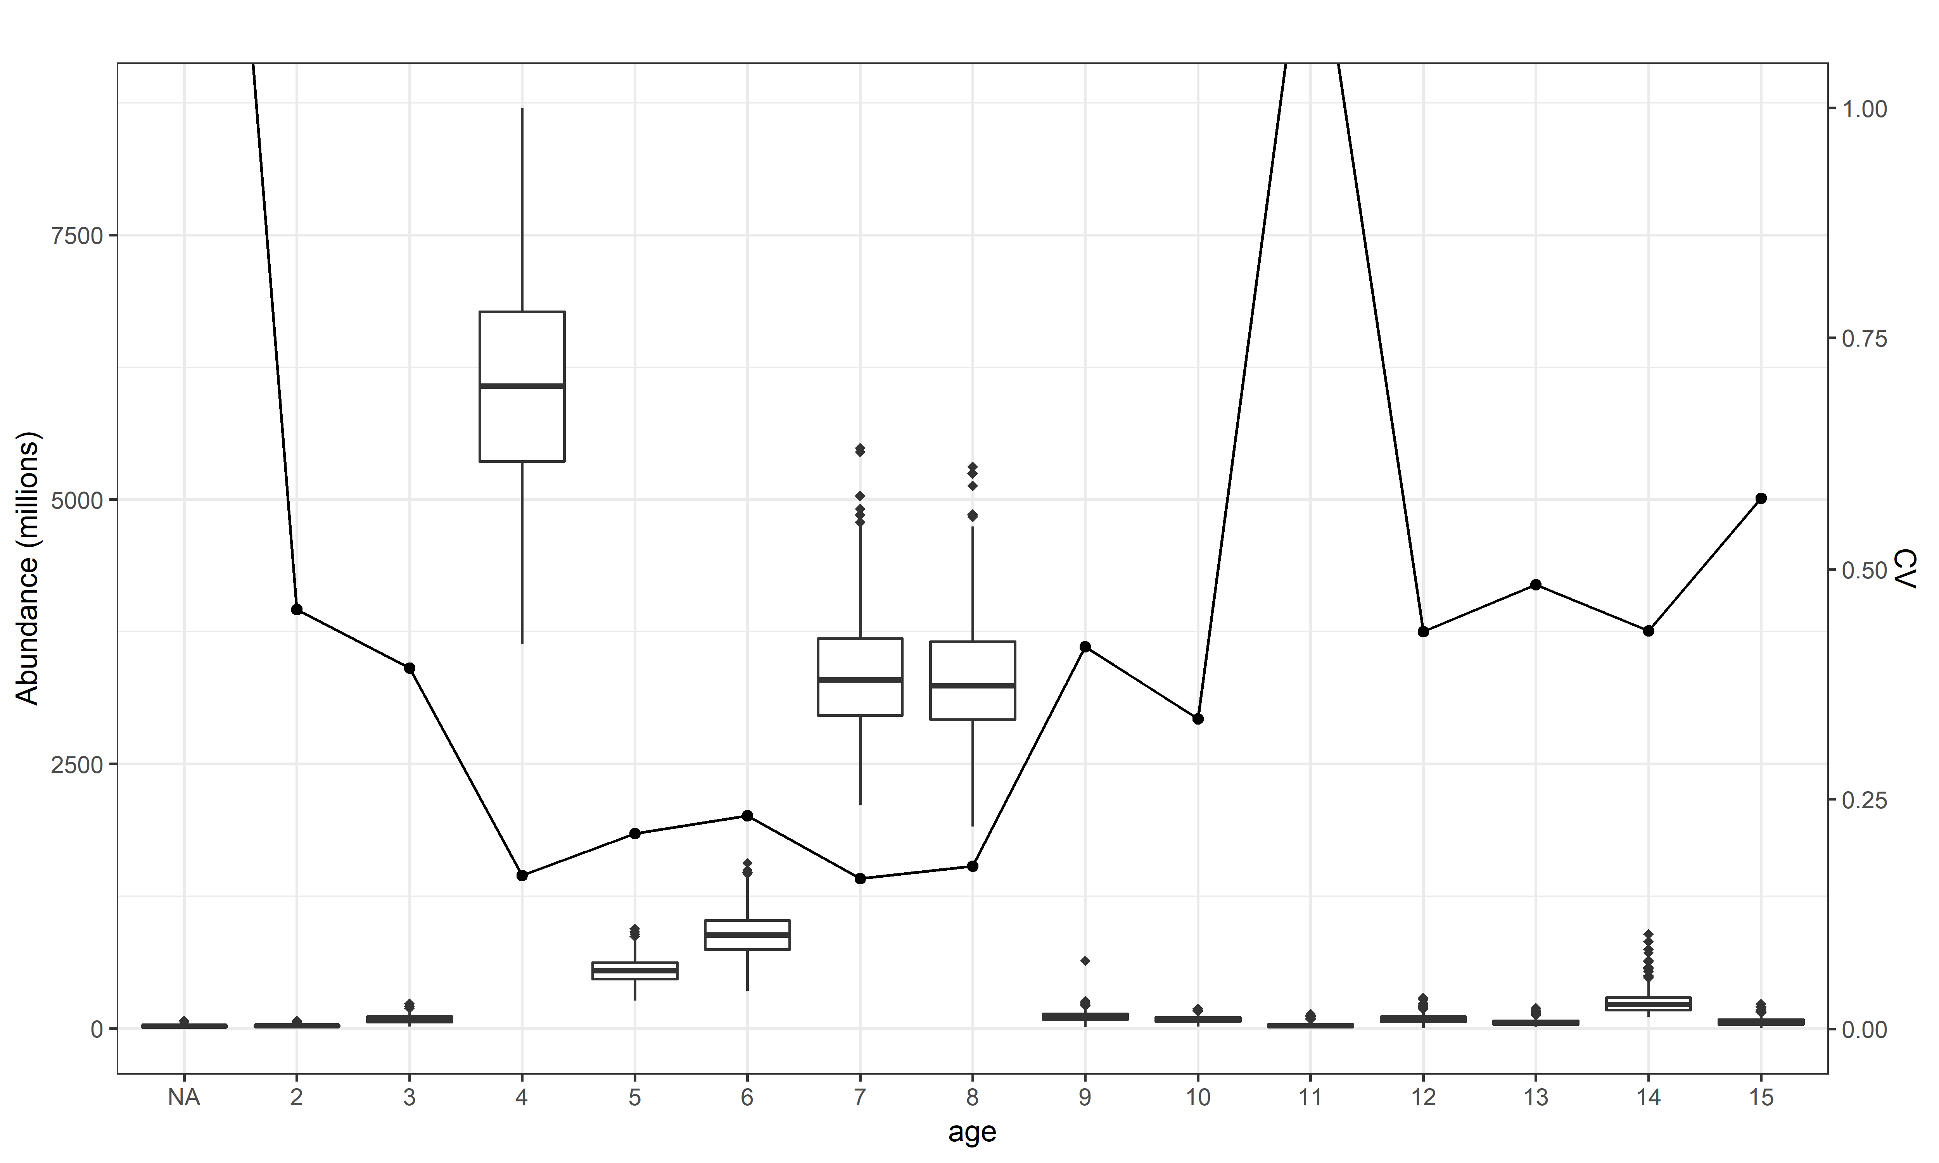
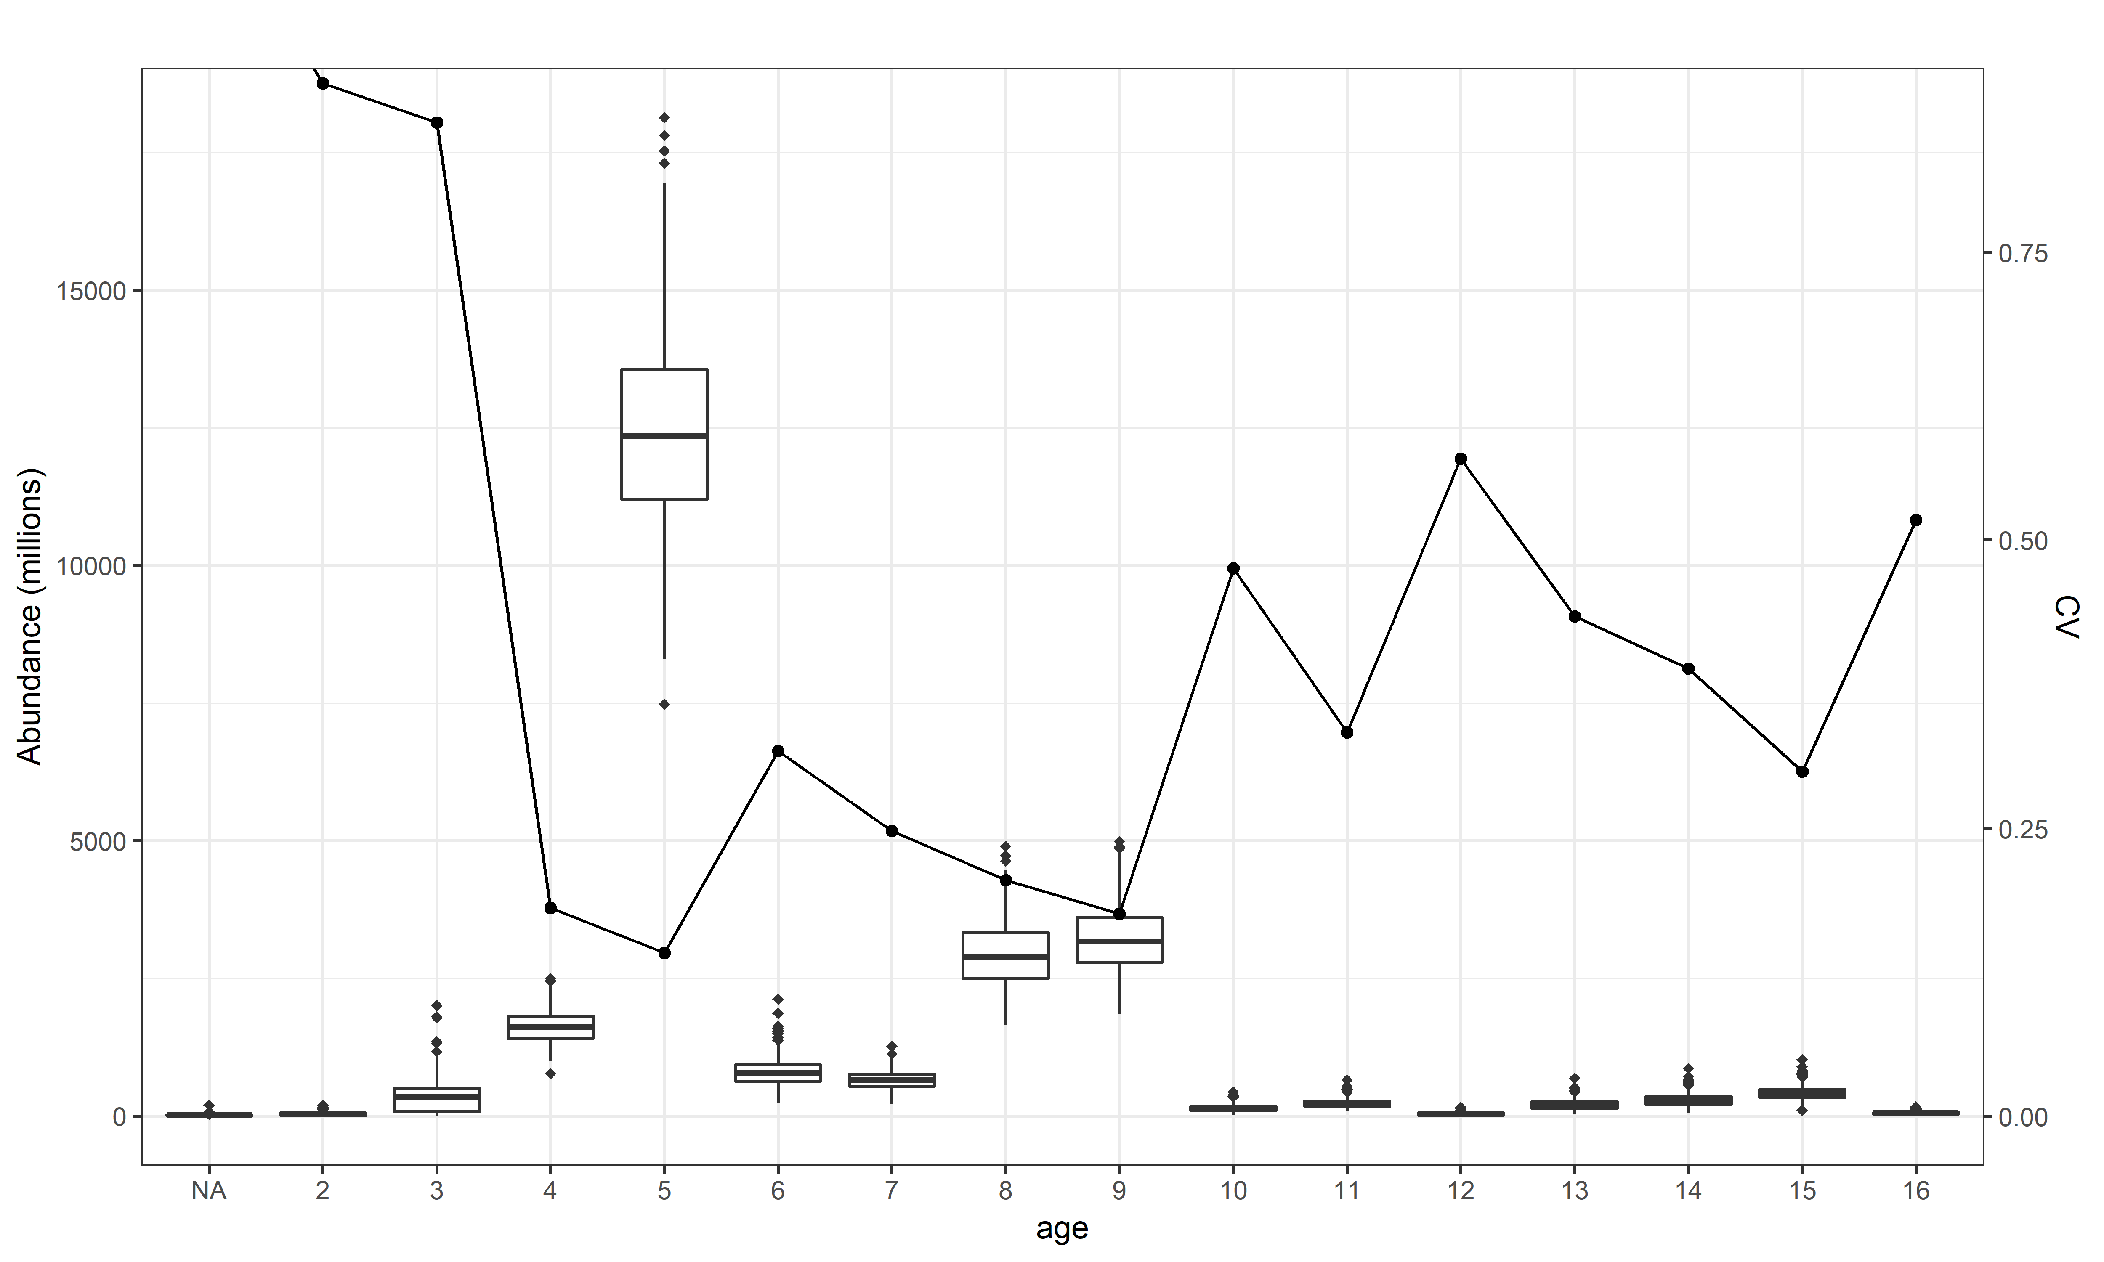
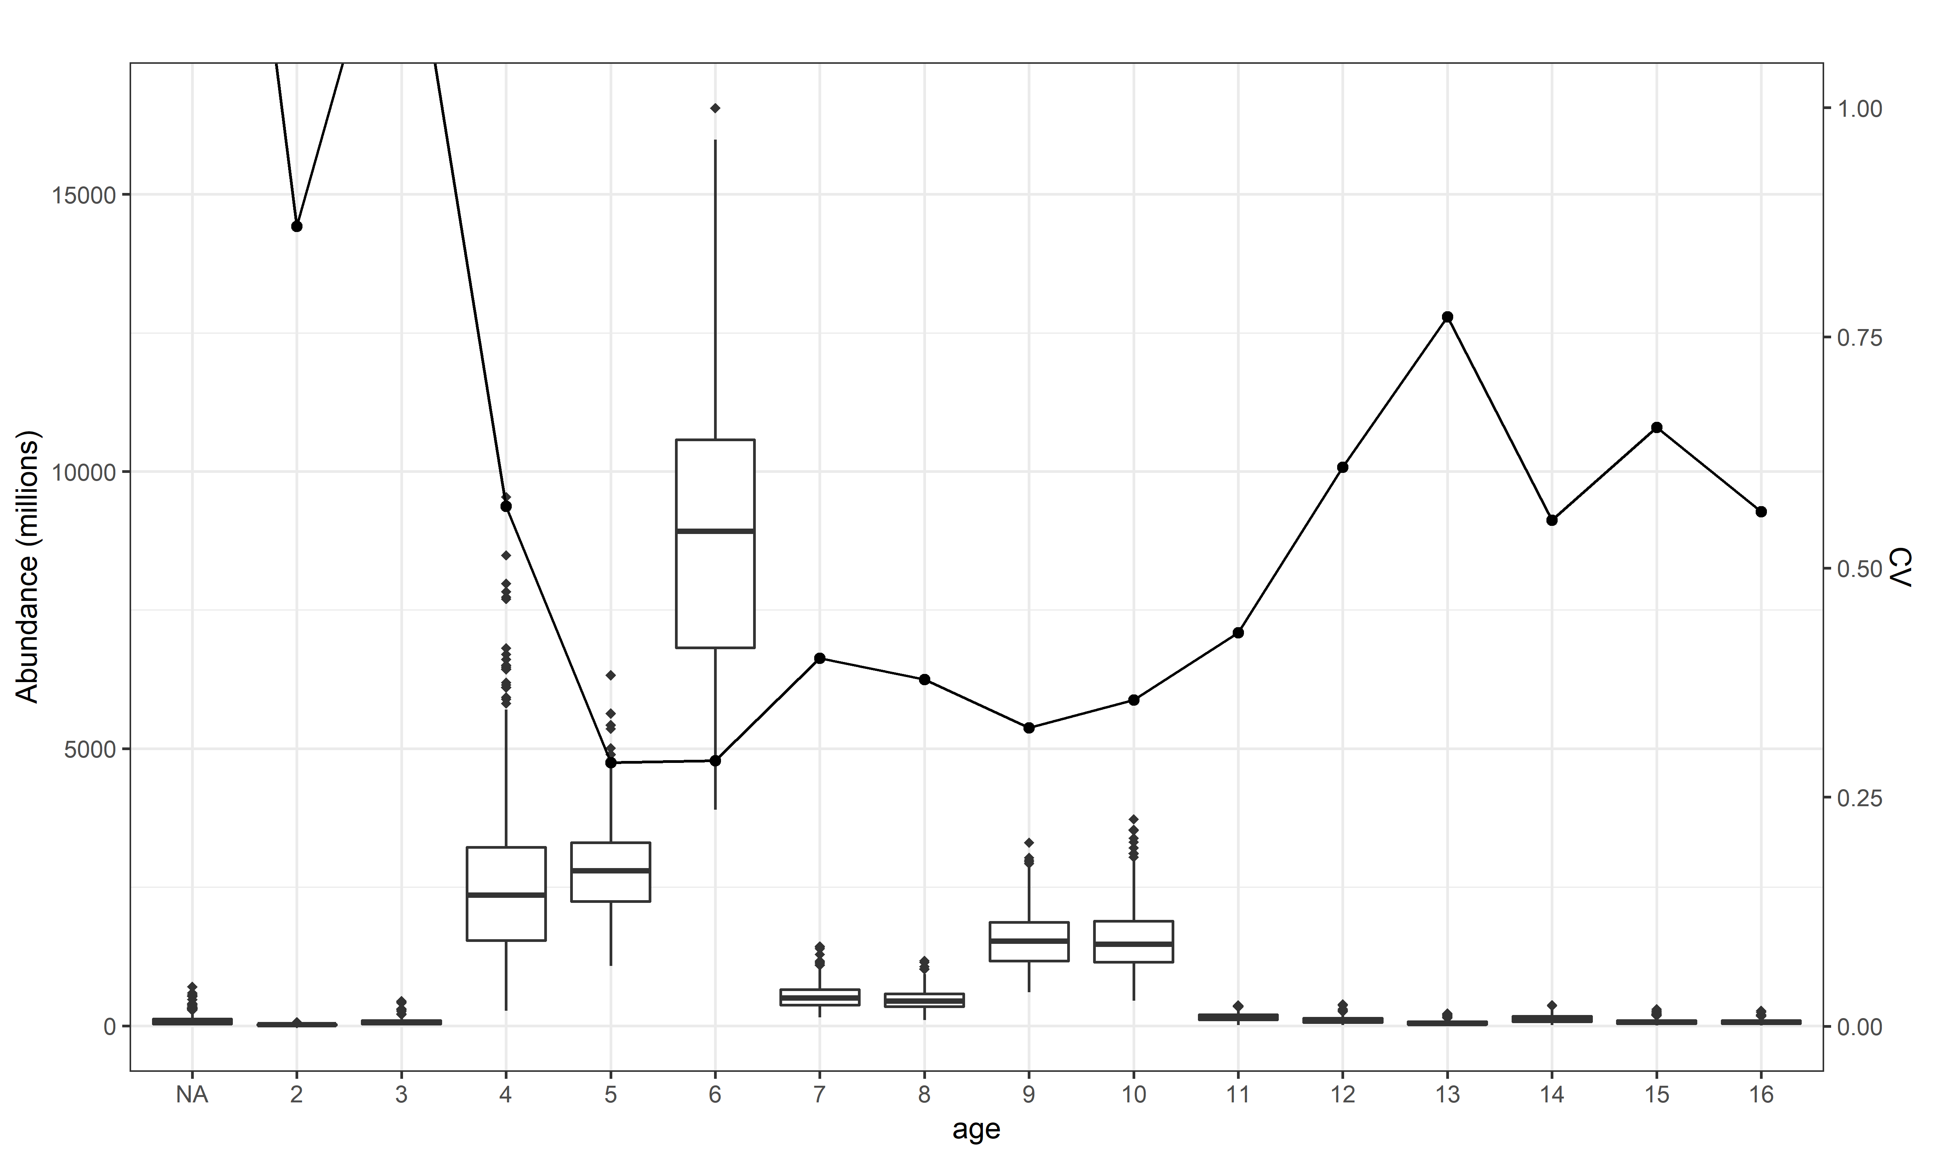
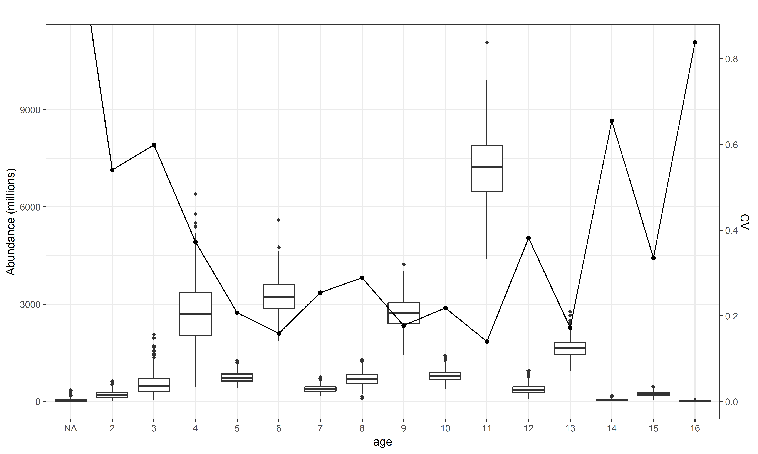
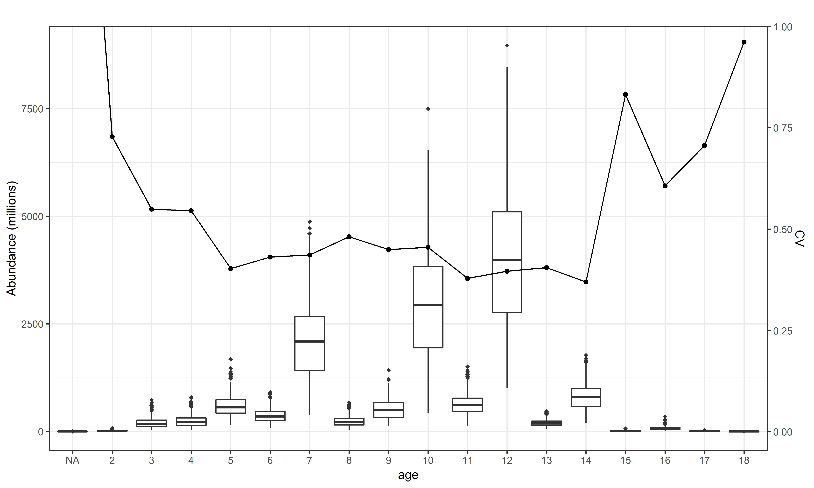
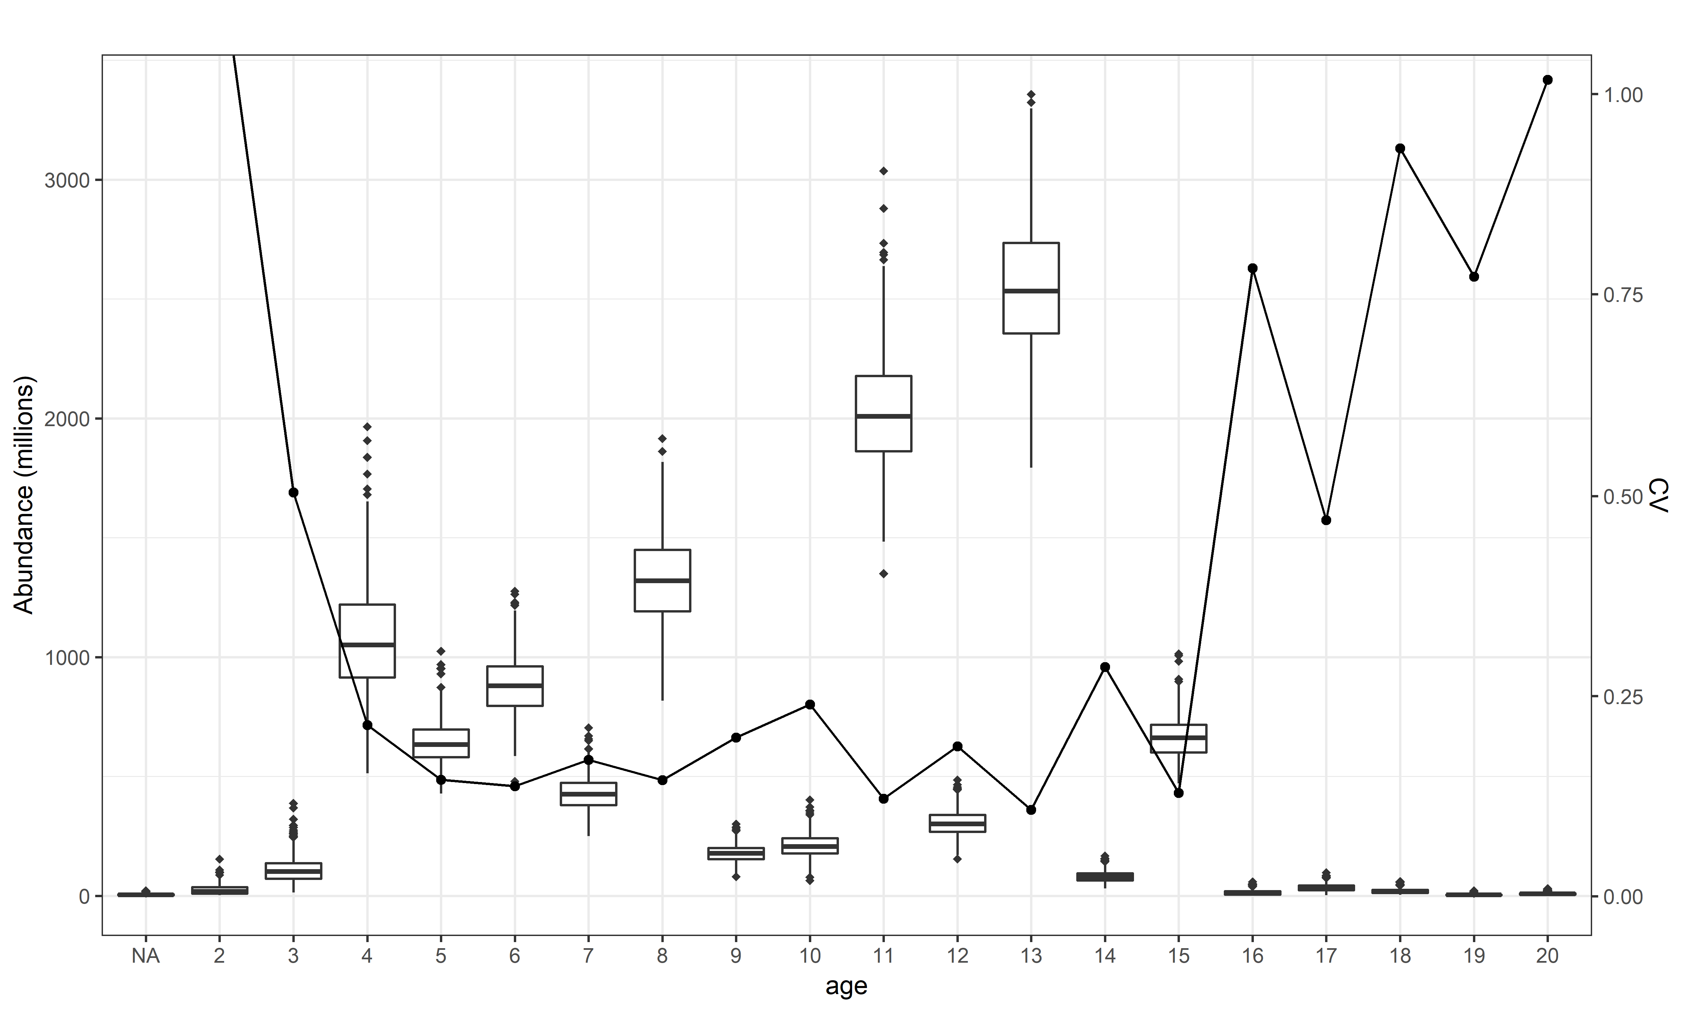
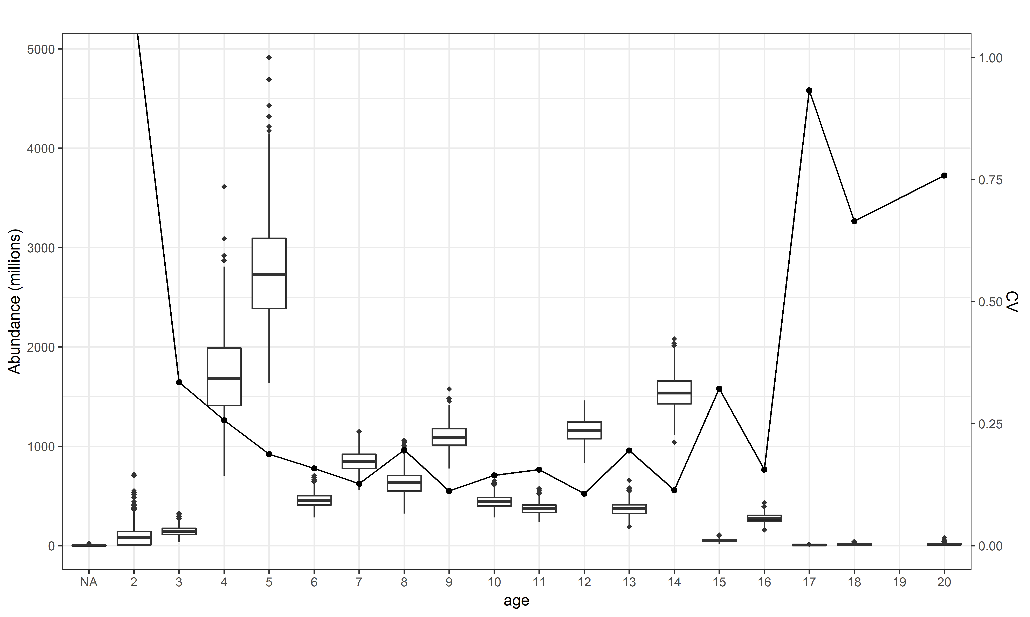
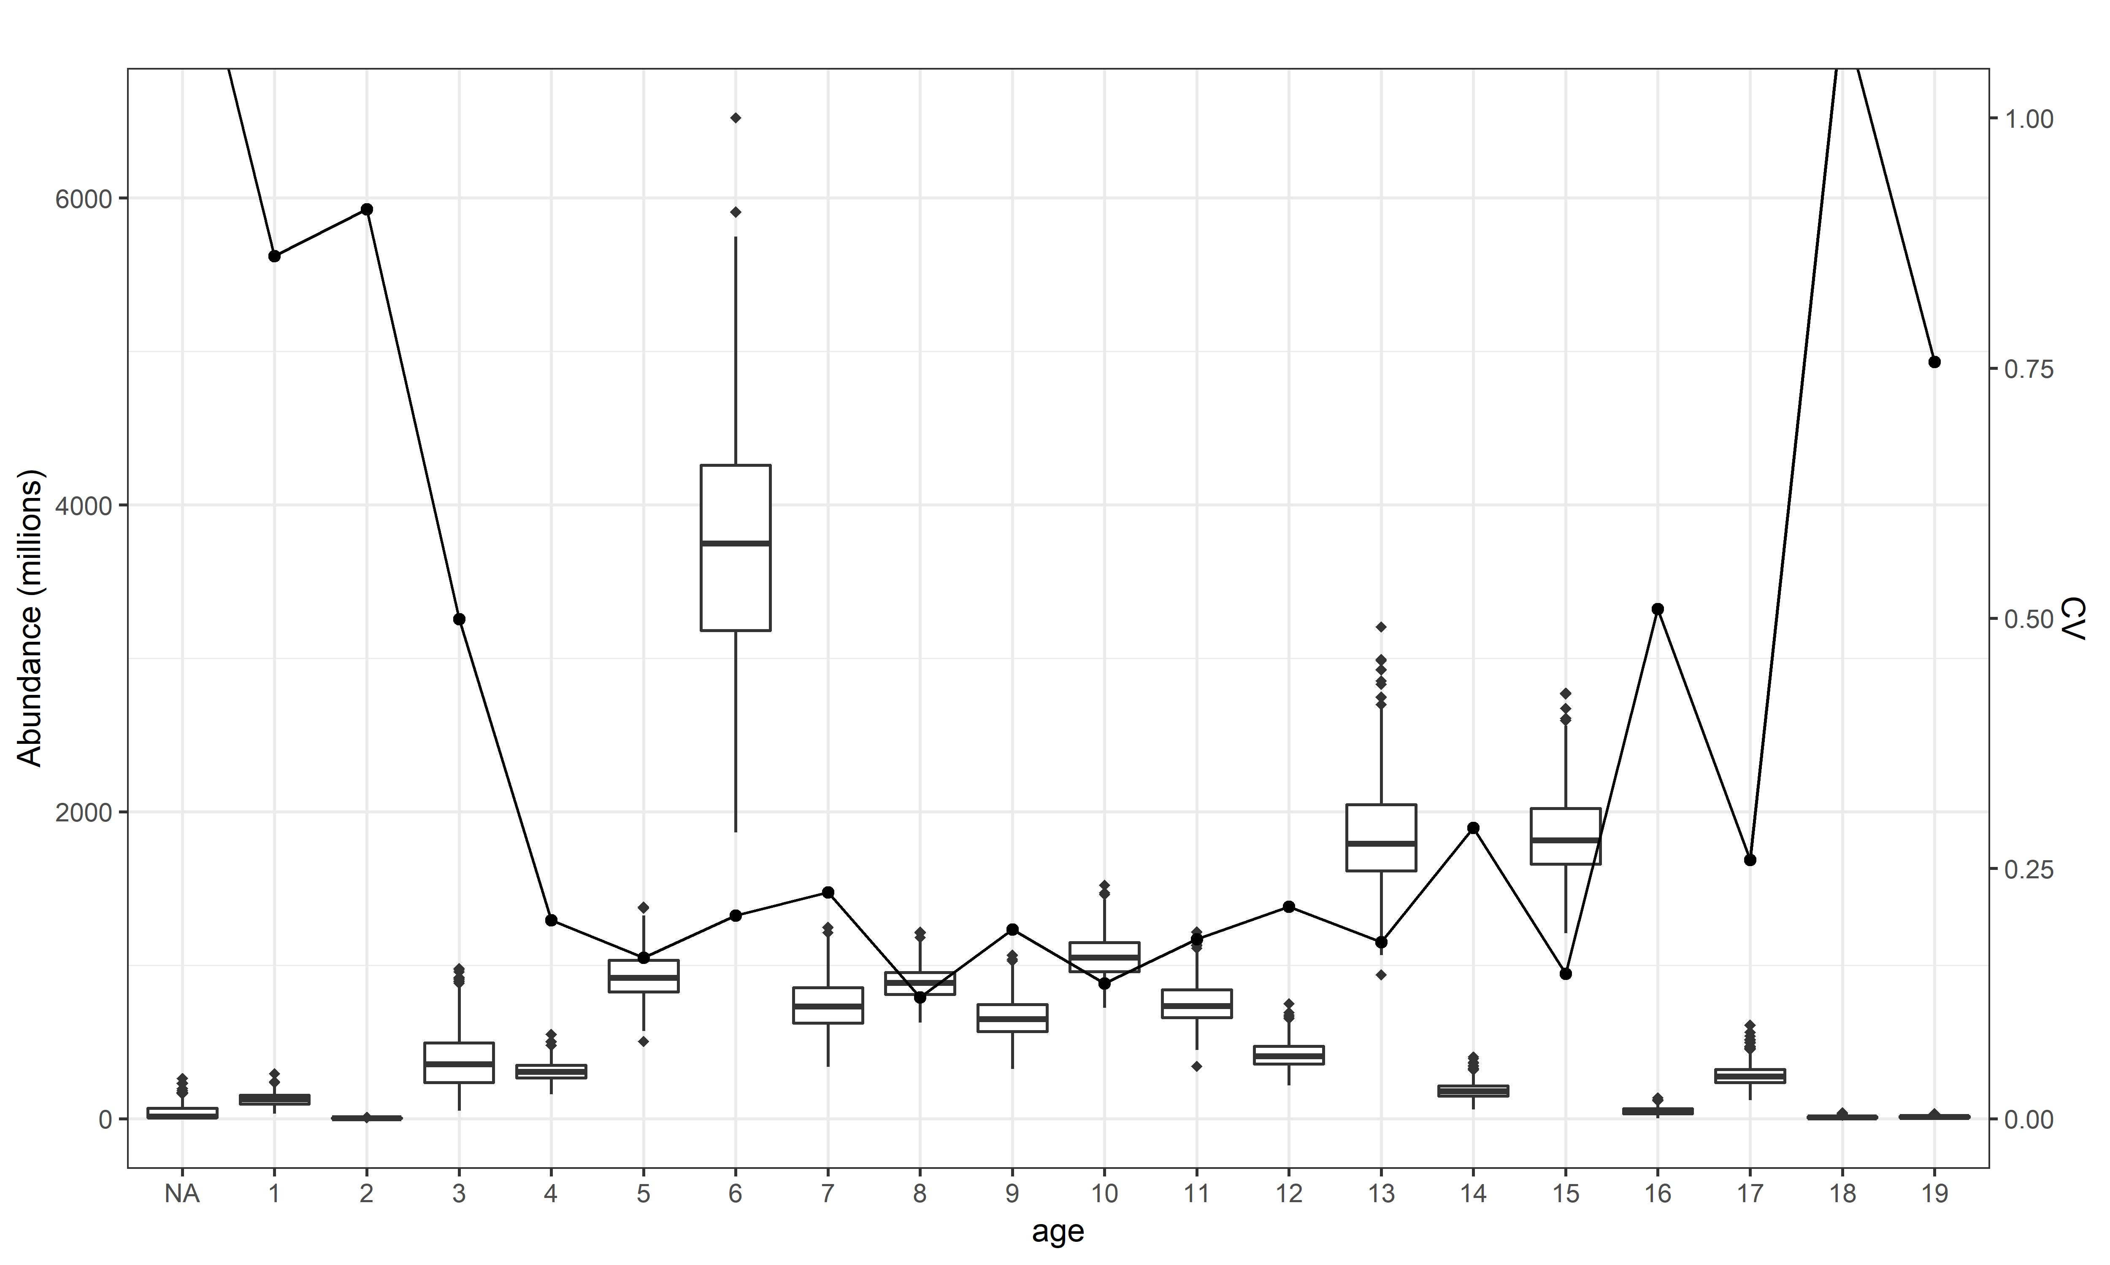
Data precision fleet 1
2006
2007
2008
2015
2016
2017
2018
2019

Slide 5
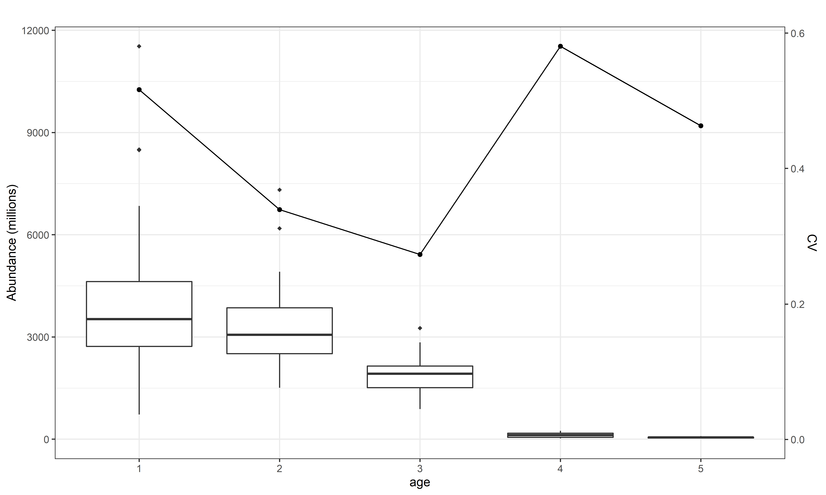
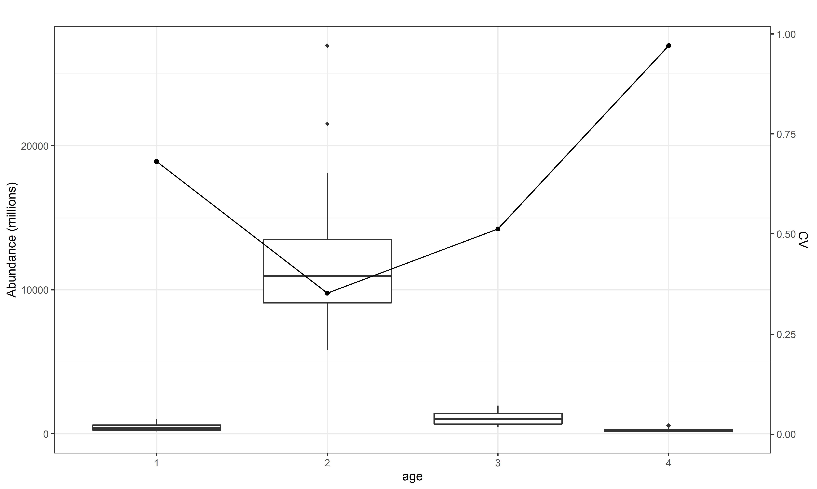
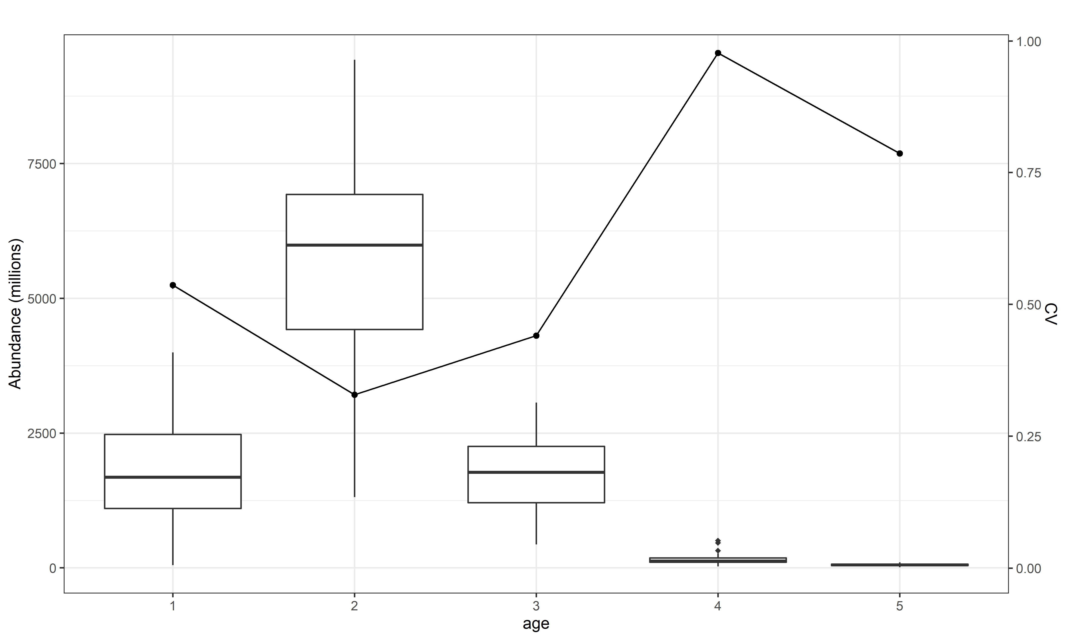
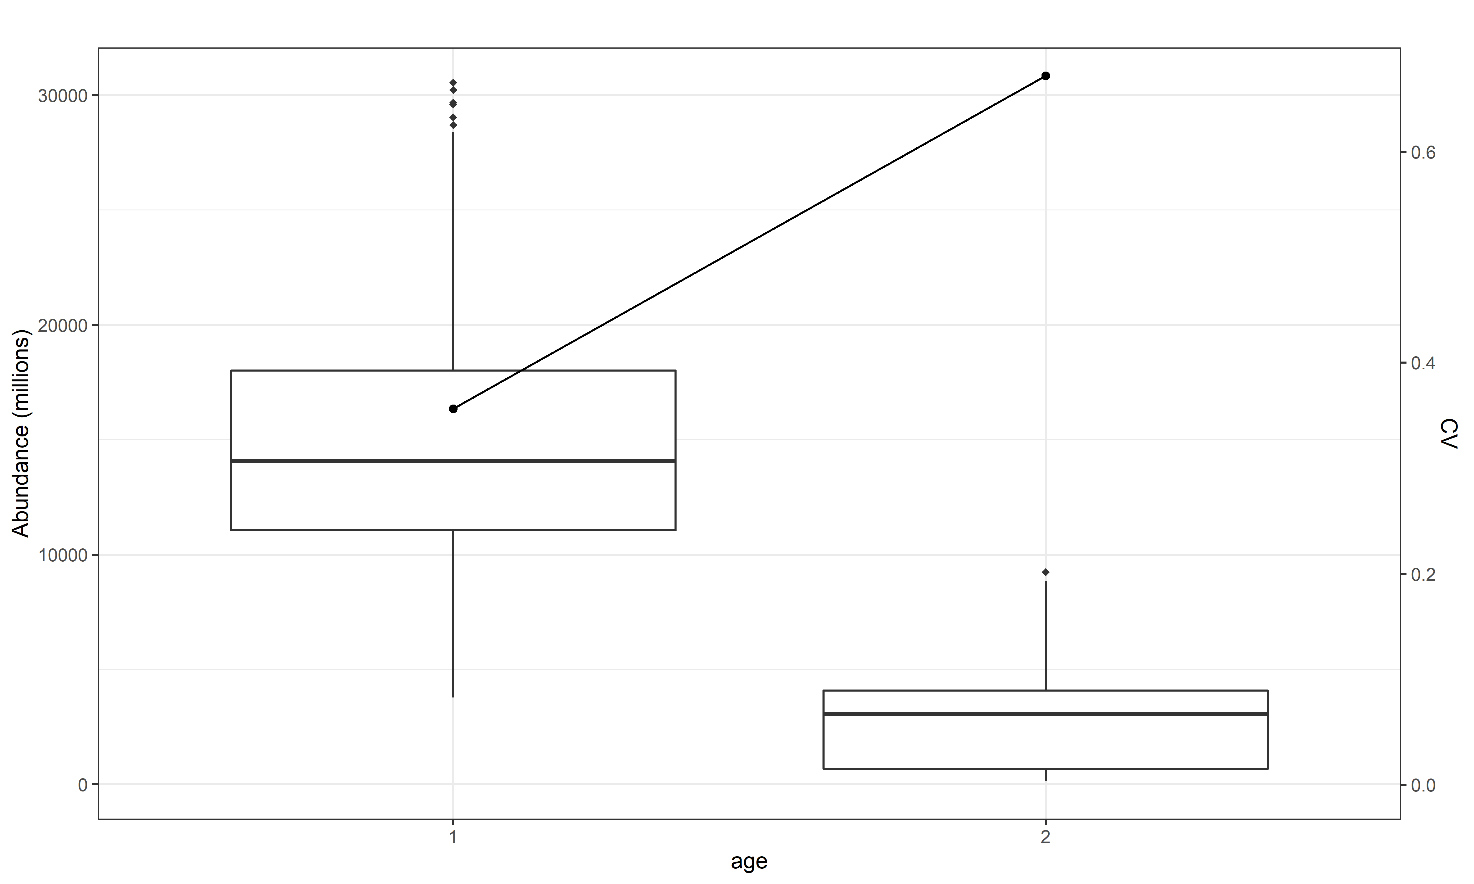
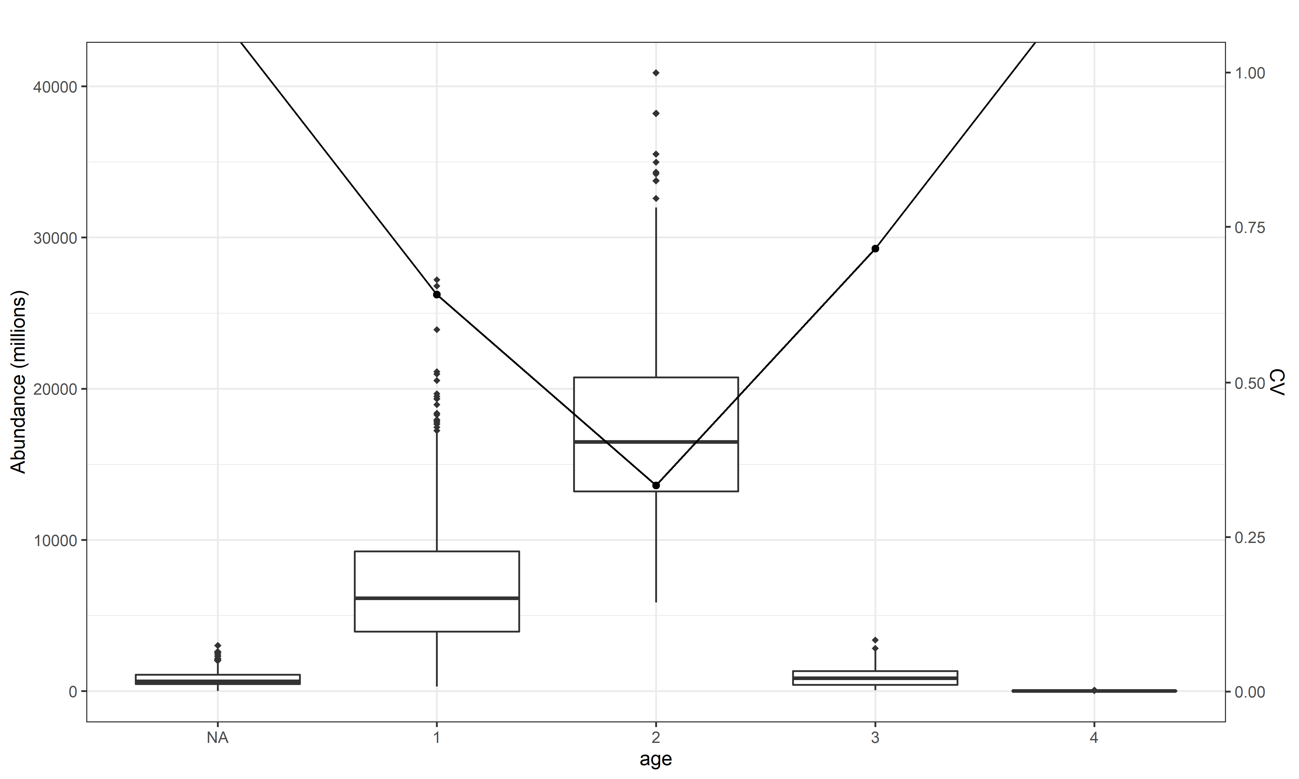
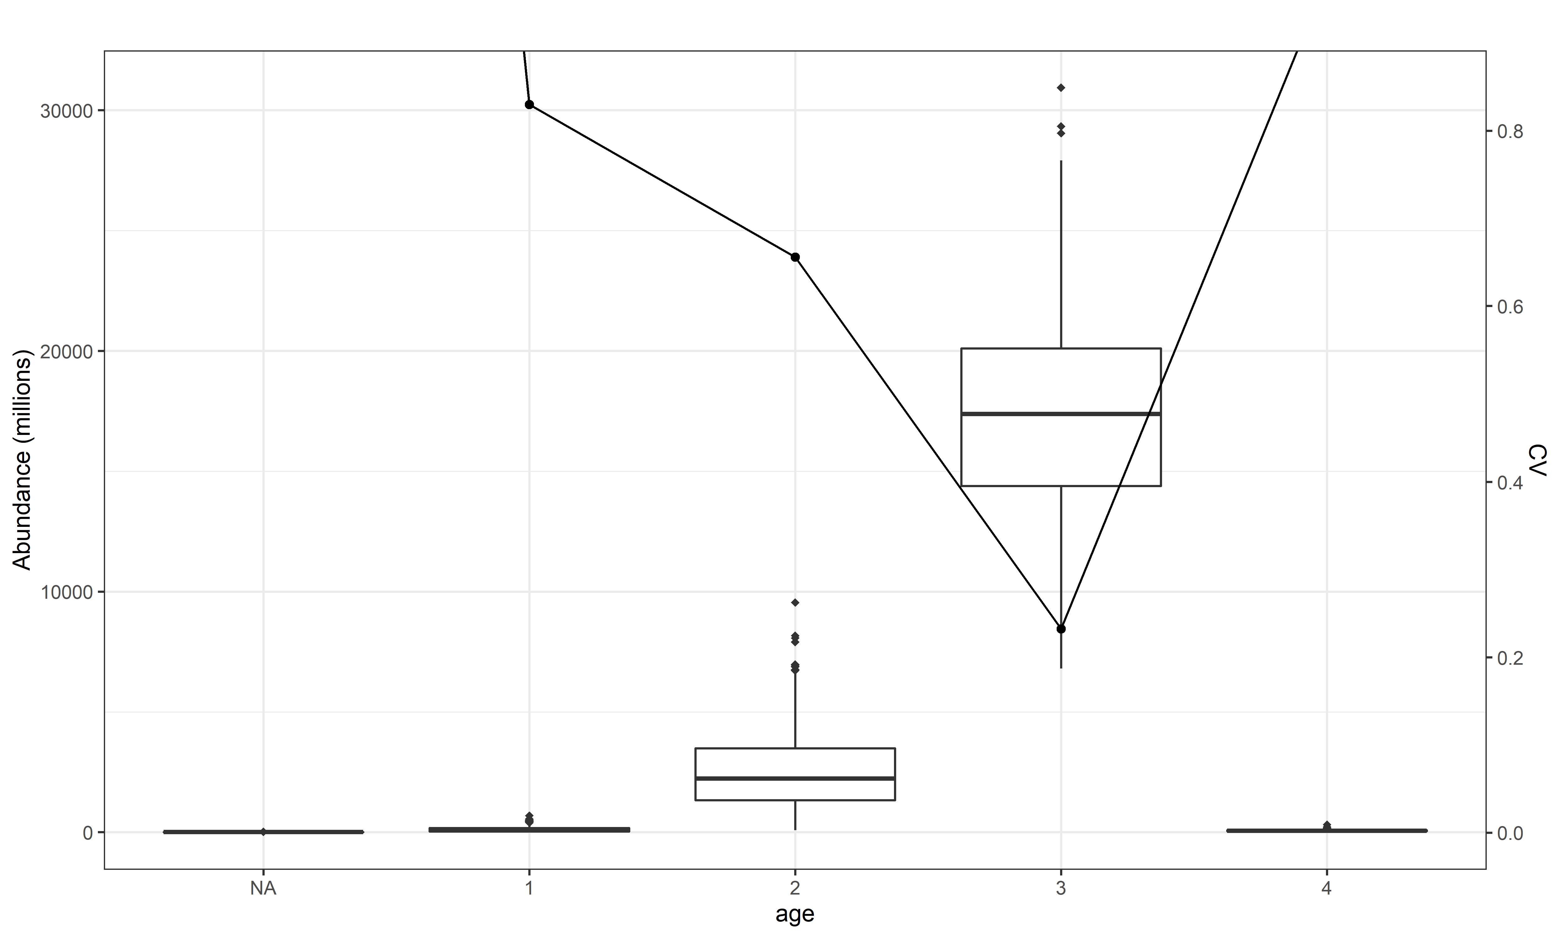
Data precision fleet 4
2014
2015
2016
2017
2018
2019

Slide 6
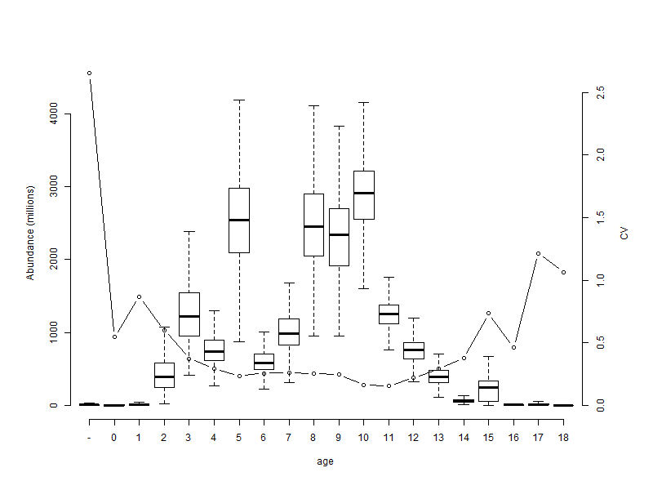
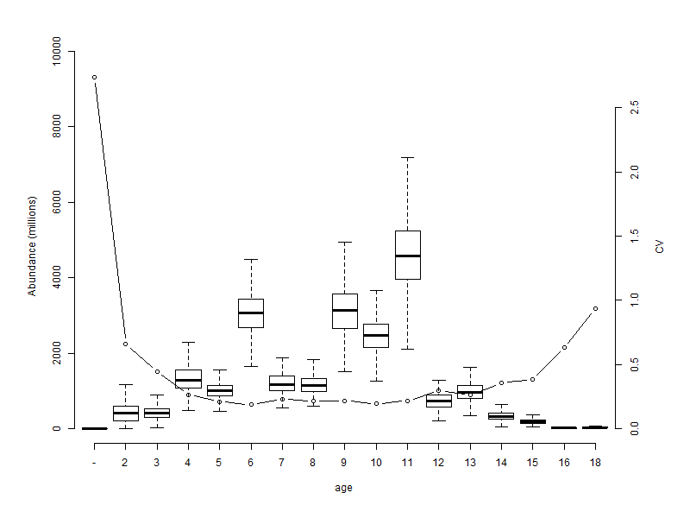
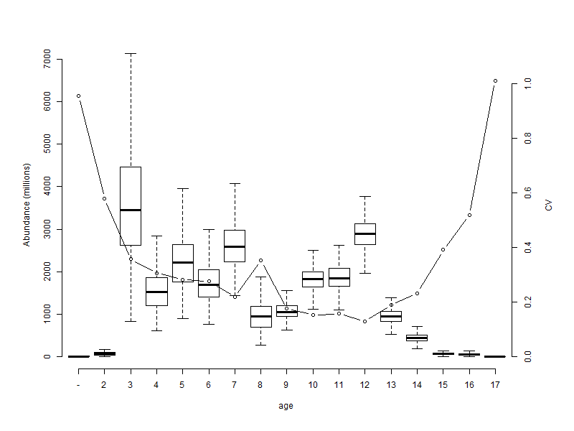
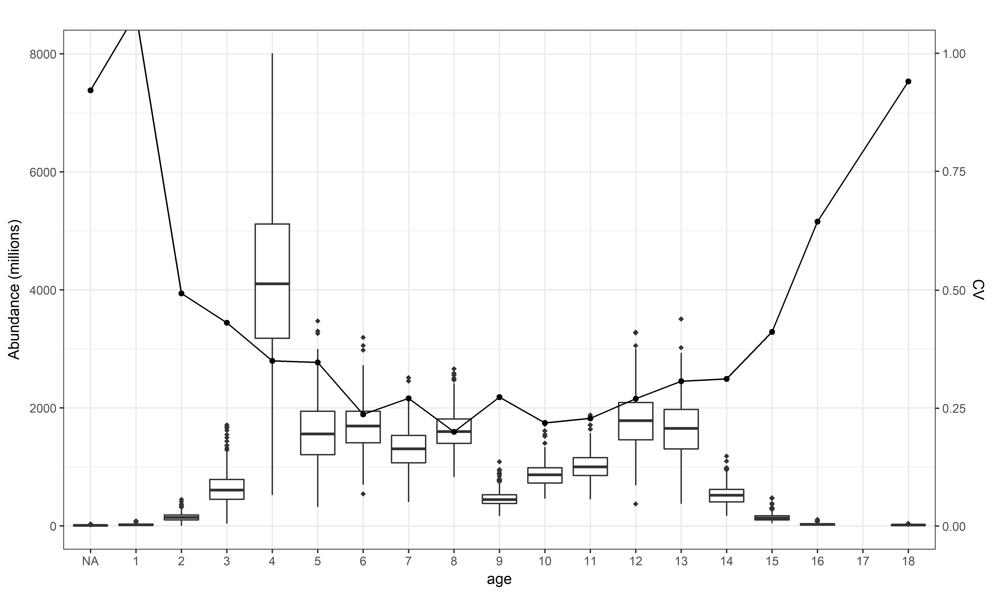
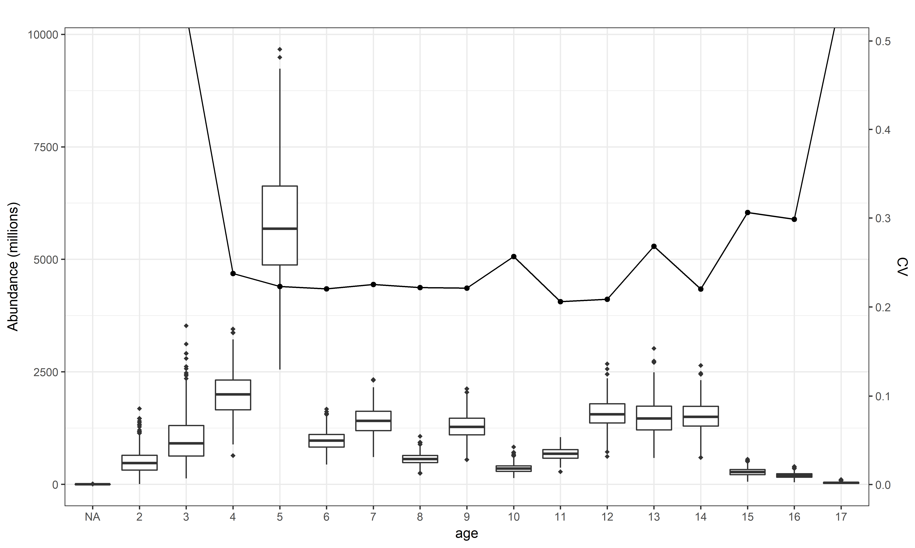
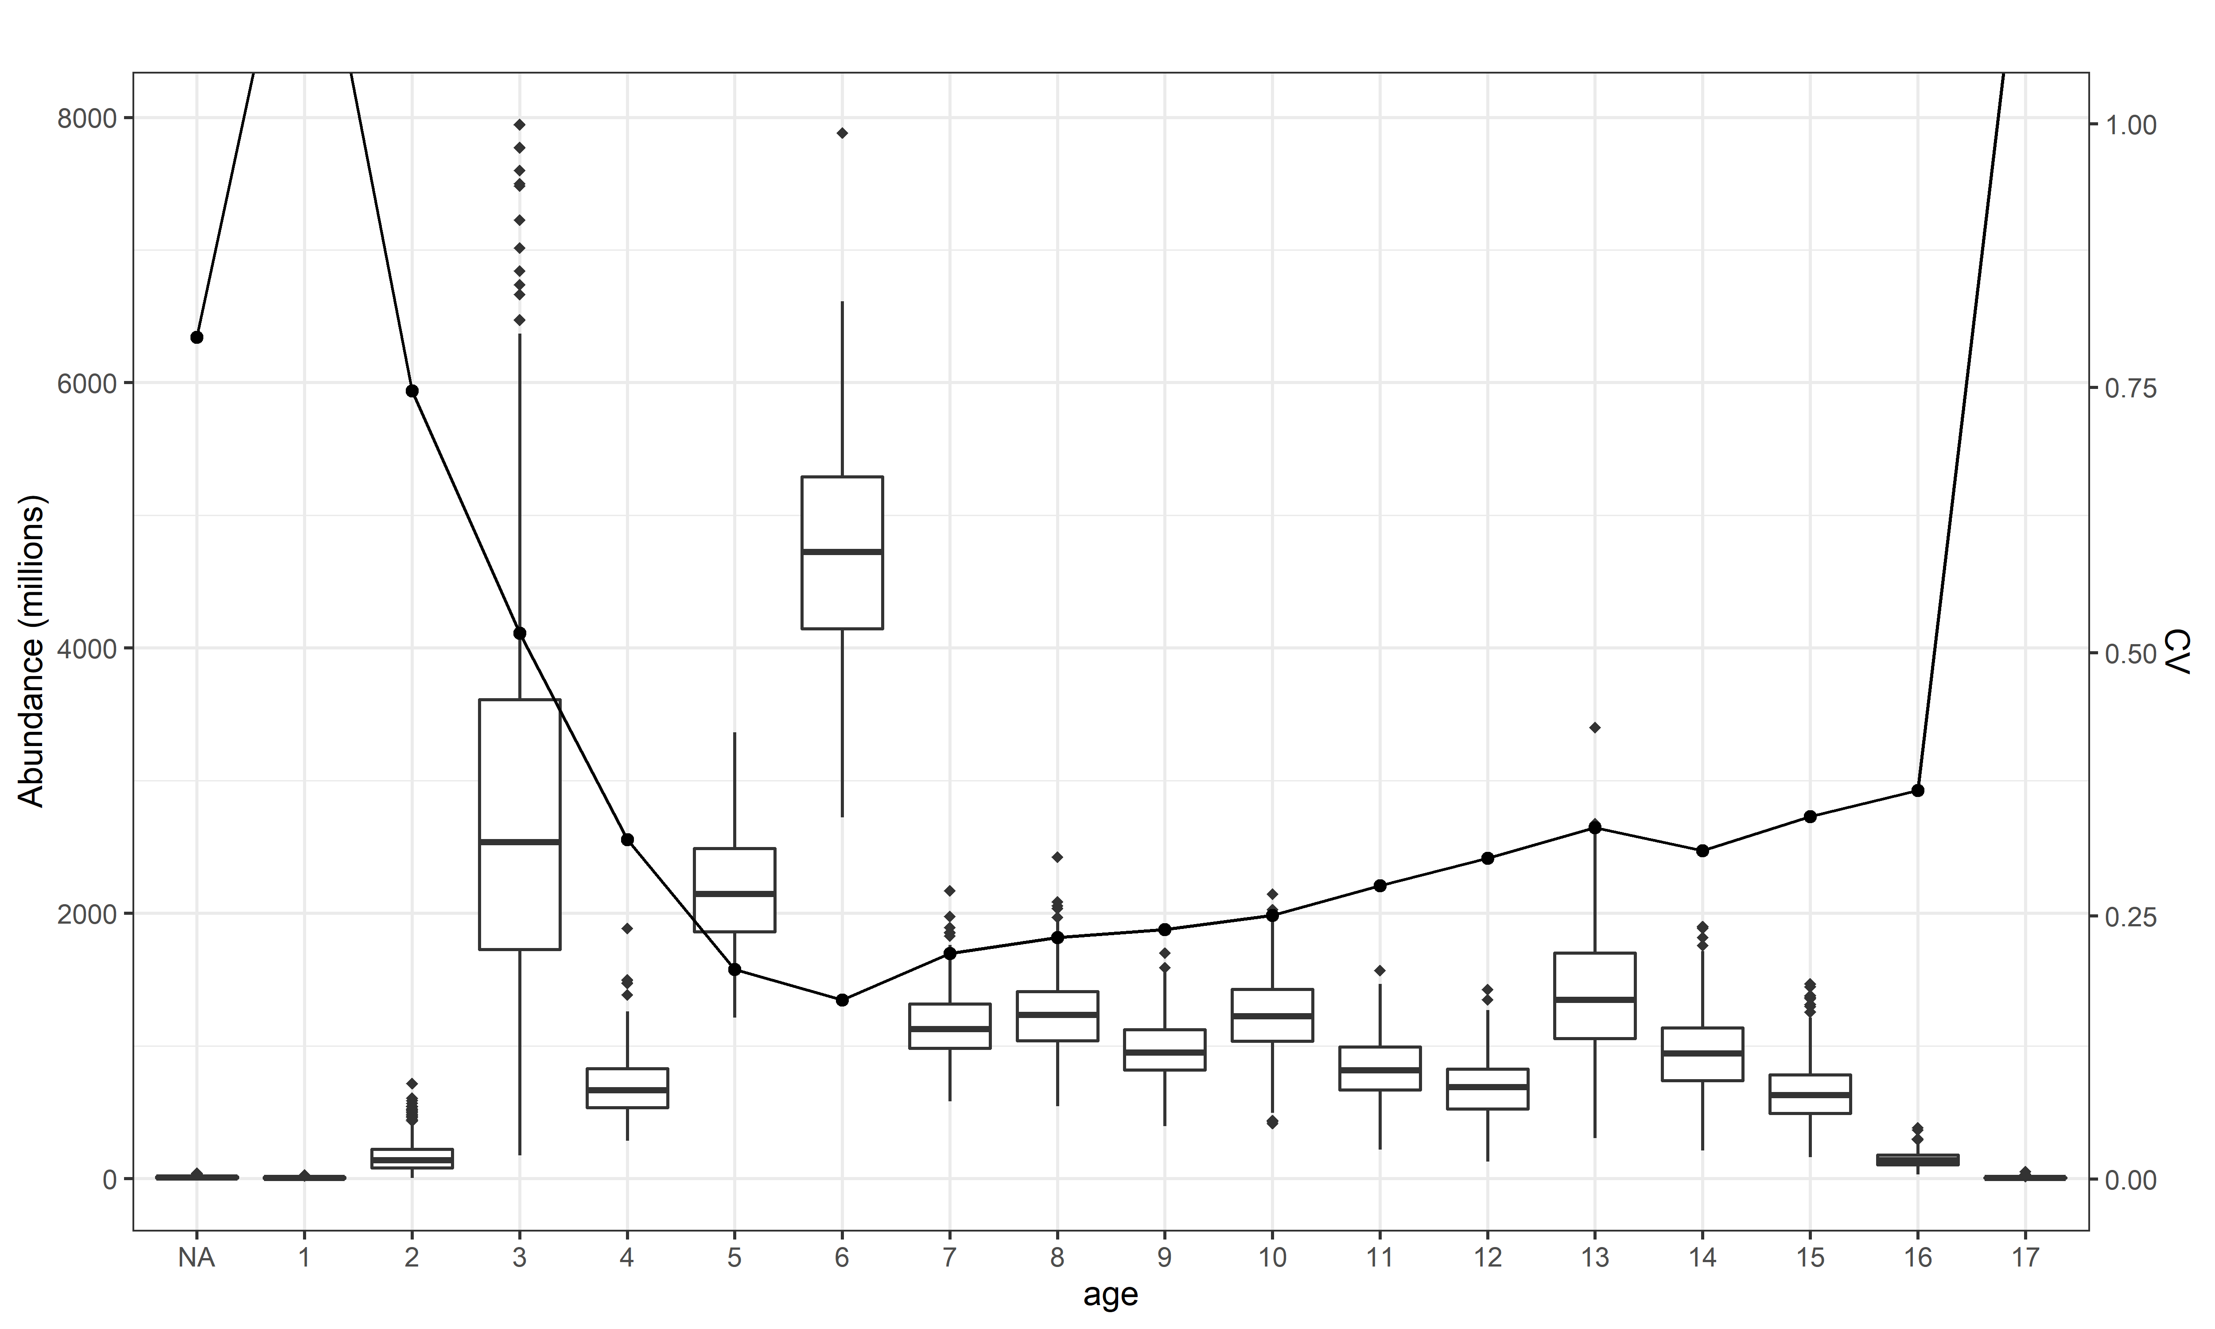
Data precision fleet 5
2014
2015
2016
2017
2018
2019

Slide 7
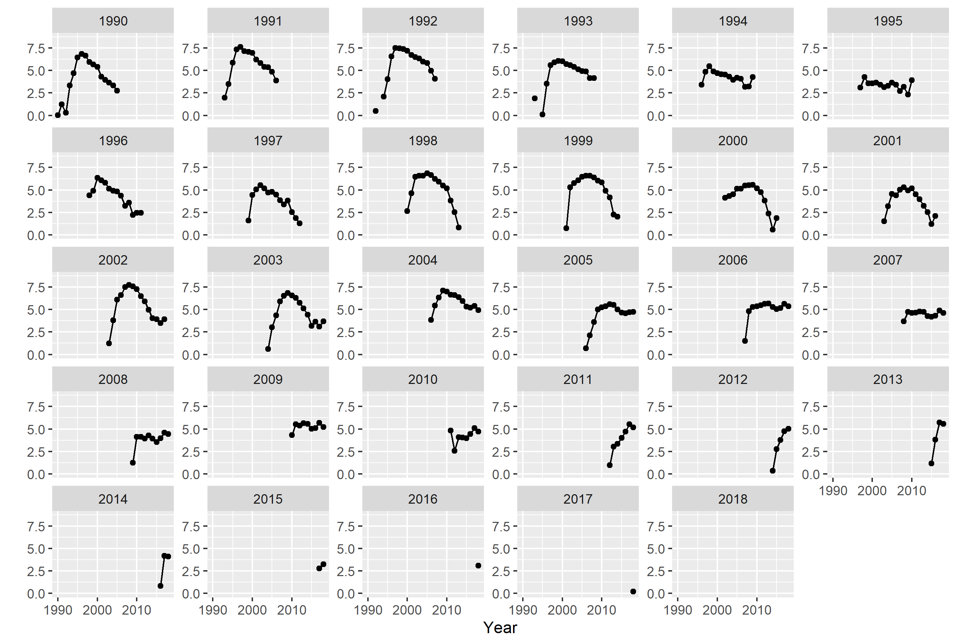
Data signals – Catch at age

Slide 8
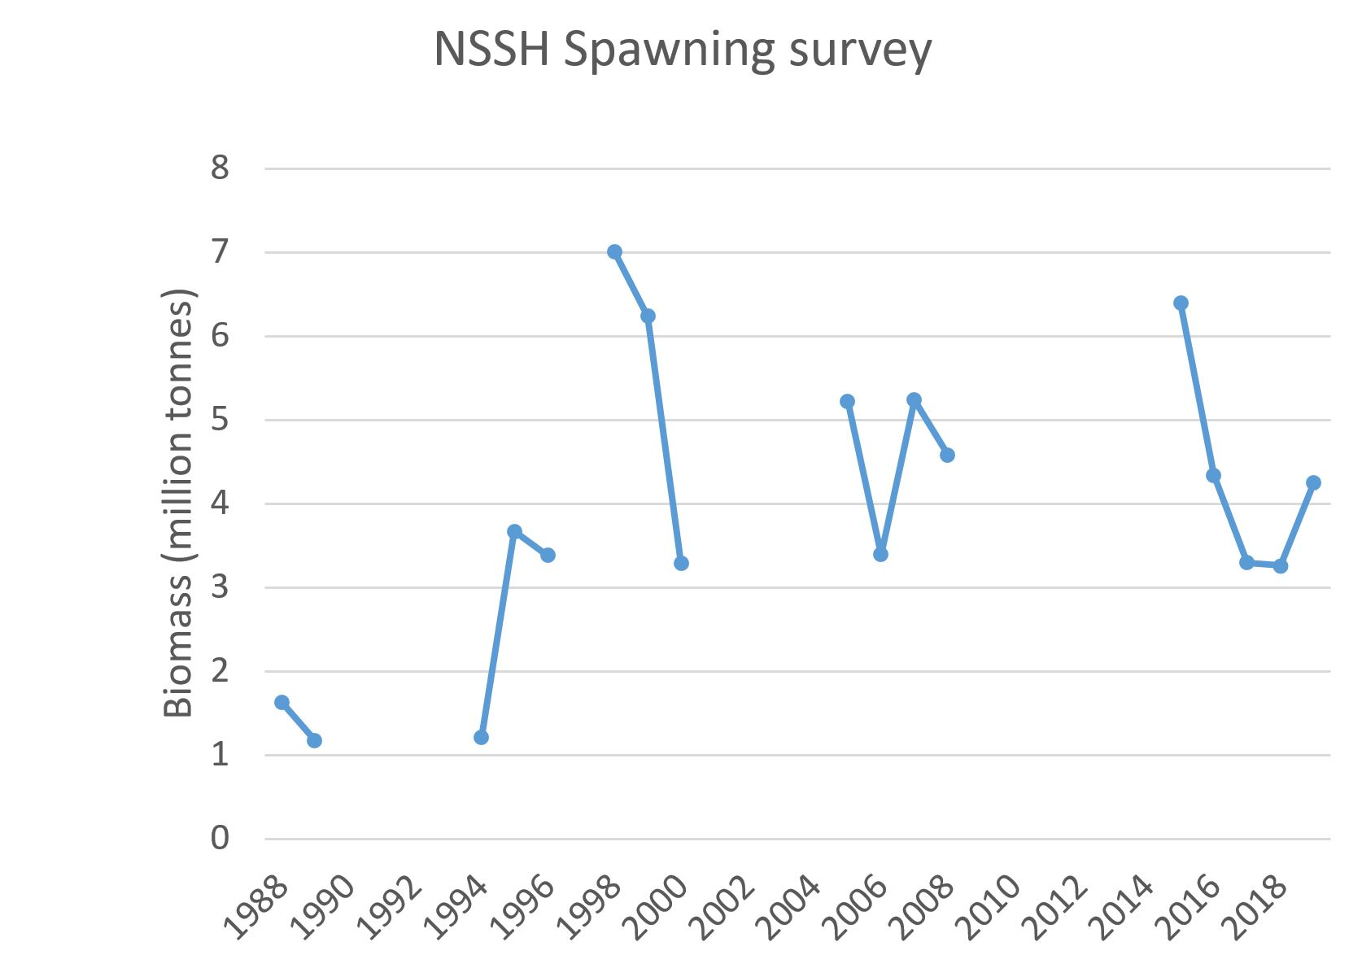
Request from yesterday

Slide 9
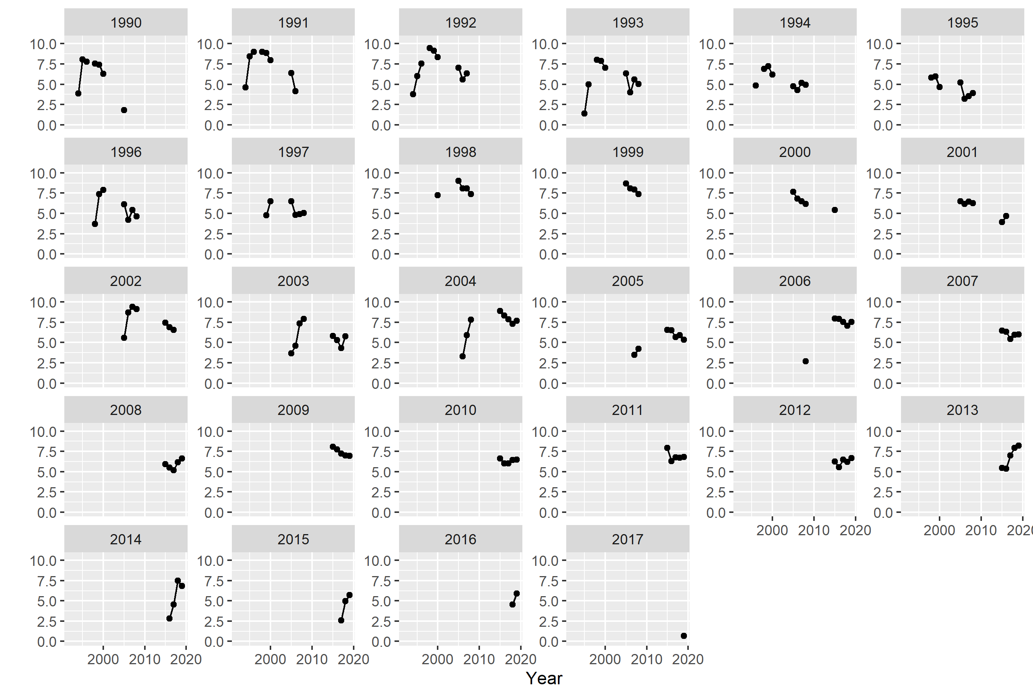
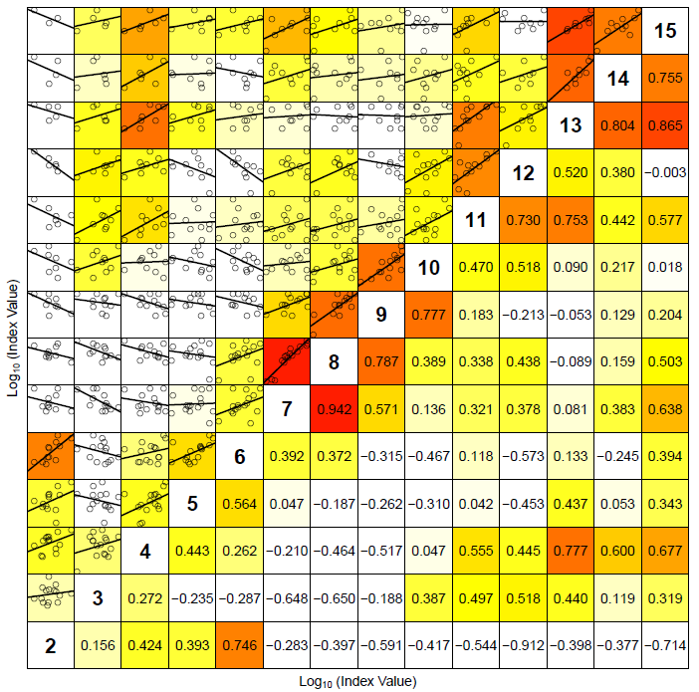
Data signals – Fleet 1

Slide 10
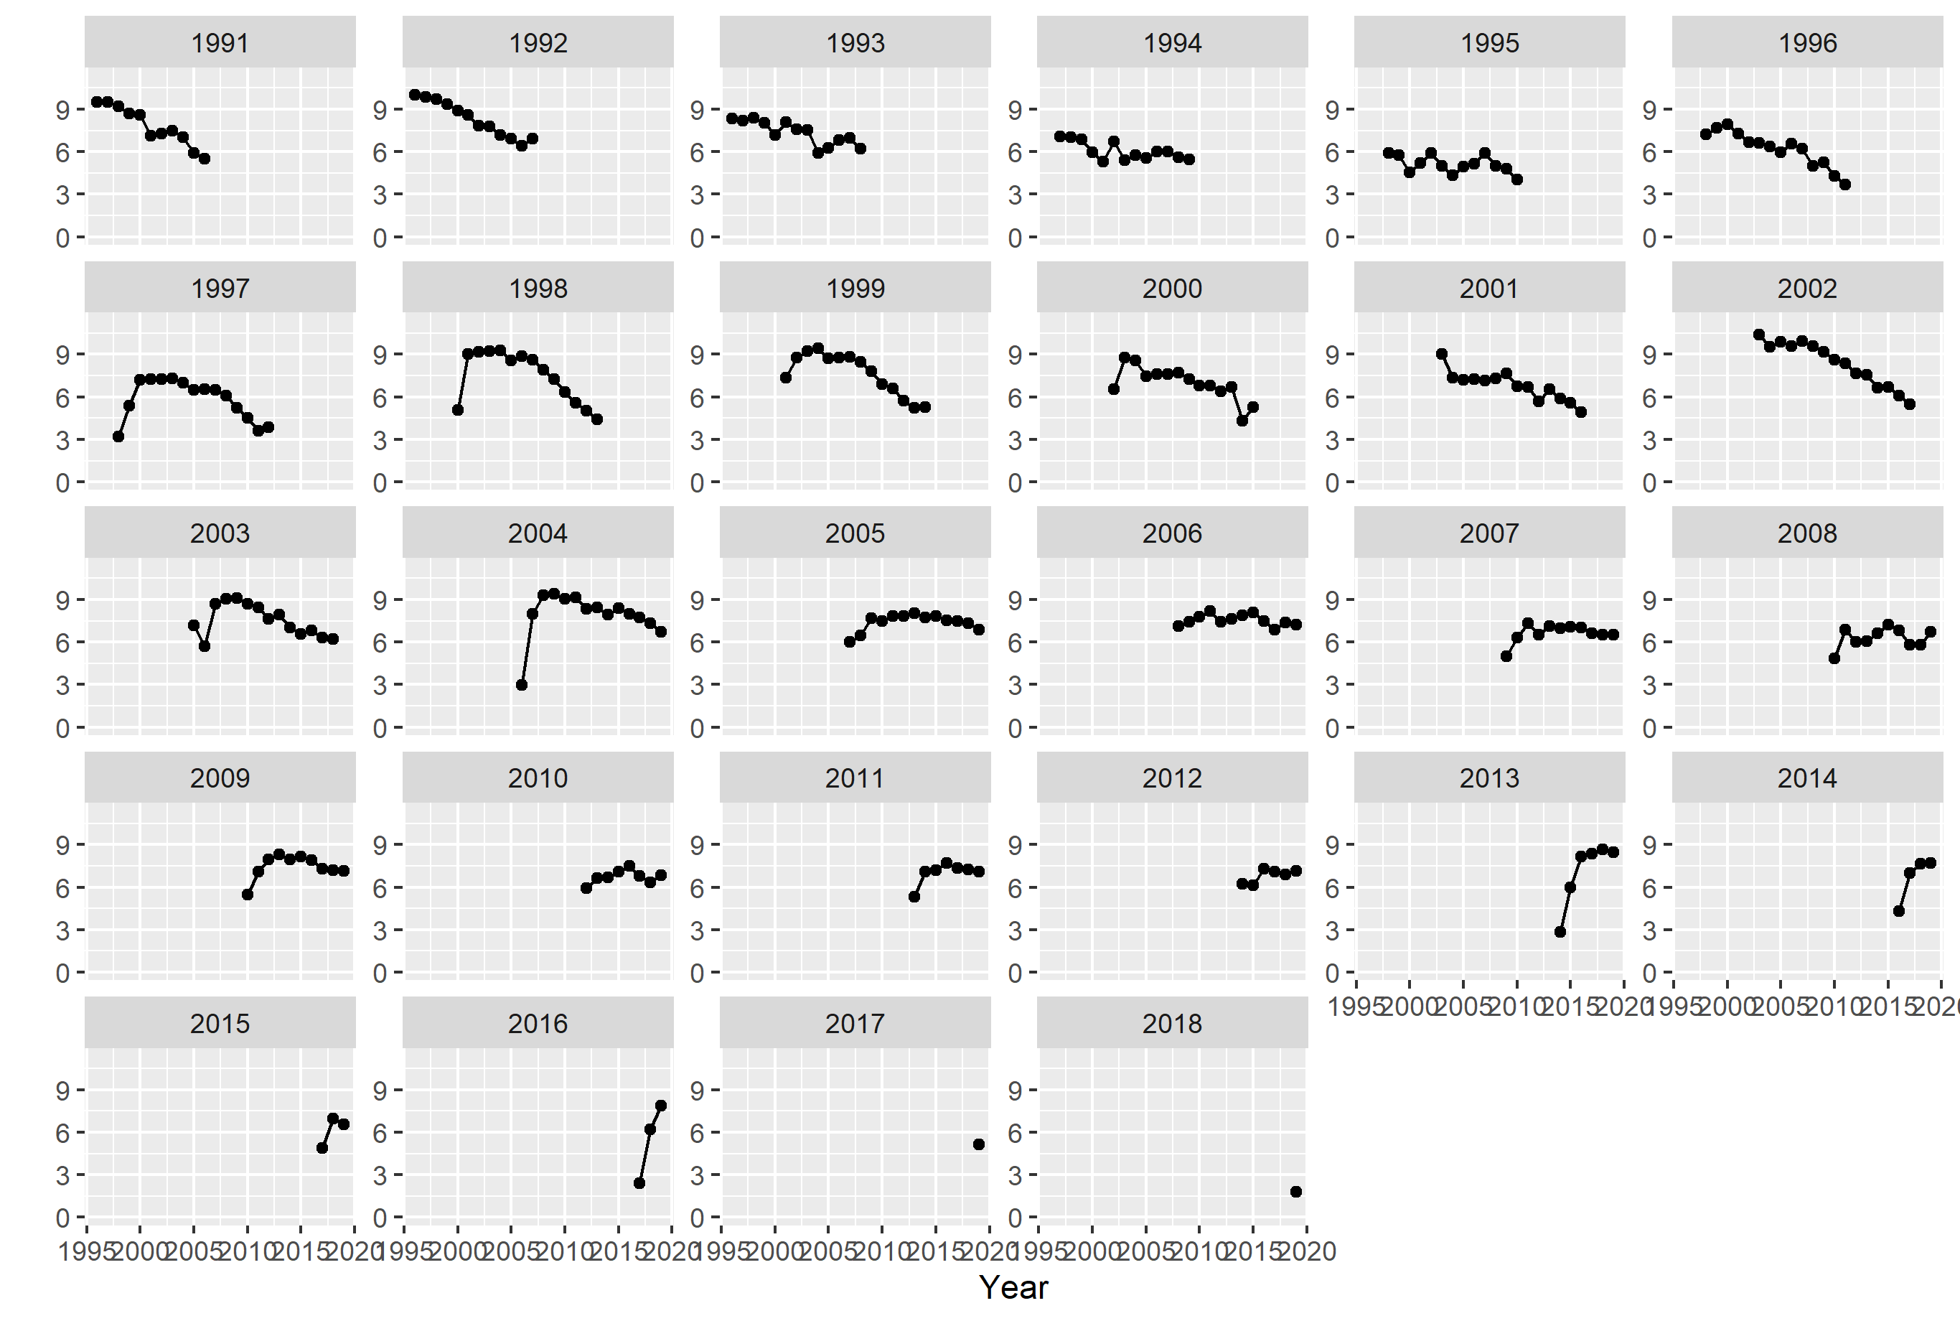
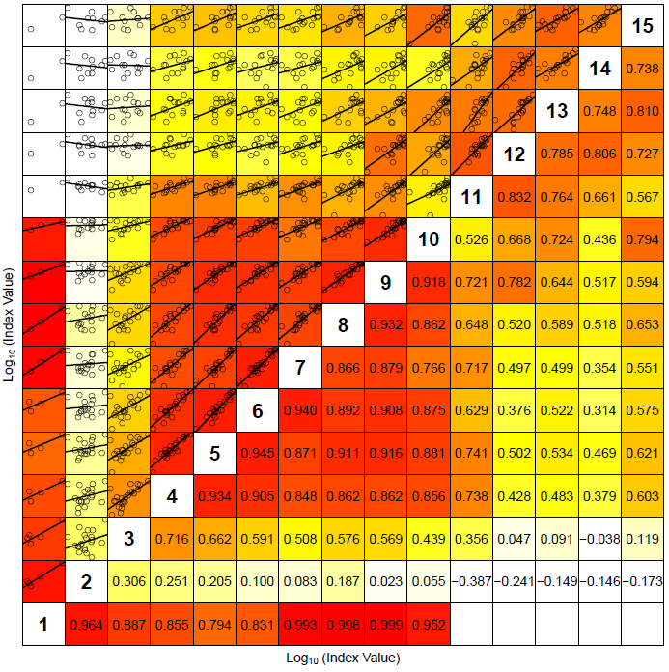
Data signals – Fleet 5

Slide 11
Model setup
Data: Catch at age, Fleet 1 (3-12+), Fleet 4 (2), Fleet 5 (3-12+)
Age range: 2-12+
Years: 1988-2019
Separable model for F with noise, selection pattern and effort changes according to AR(1)
Catchabilities:
Fleet 1: q-plateau 8-12
Fleet 4: only age 2
Fleet 5: q-plateau 11-12
Use of catch prediction as data input in assessment year: Changed in 2017. Not used: Does not affect assessment, but was found to effect prediction of selectivity, and thus forecast, in an unexpected way. The reason is identified and was caused by too high variability in selectivity for the oldest ages.
Use estimated levels of precision:
Catch at age: as estimated for Norwegian catch at age by ECA
Abundance at age: as estimated by StoX
Apply model for variances to reduce effect of imprecise estimates of variance
Set precision in XSAM proportional to variances

Slide 12
Model - parameters
 | Estimate | Std. Error | cv
initlogN1 | 7.075 | 0.17 | 0.024
initlogN2 | 6.604 | 0.209 | 0.032
initlogN3 | 9.584 | 0.076 | 0.008
initlogN4 | 4.812 | 0.369 | 0.077
initlogN5 | 3.487 | 0.506 | 0.145
initlogN6 | 3.115 | 0.554 | 0.178
initlogN7 | 4.08 | 0.445 | 0.109
initlogN8 | 3.275 | 0.645 | 0.197
initlogN9 | 3.054 | 0.693 | 0.227
initlogN10 | 3.502 | 0.728 | 0.208
logqpar1 | -9.594 | 0.188 | 0.02
logqpar2 | -8.102 | 0.138 | 0.017
logqpar3 | -7.555 | 0.125 | 0.017
logqpar4 | -7.31 | 0.124 | 0.017
logqpar5 | -7.165 | 0.138 | 0.019
logqpar6 | -6.925 | 0.099 | 0.014
logqpar7 | -14.304 | 0.177 | 0.012
logqpar8 | -7.609 | 0.111 | 0.015
logqpar9 | -7.157 | 0.1 | 0.014
logqpar10 | -6.911 | 0.098 | 0.014
logqpar11 | -6.779 | 0.101 | 0.015
logqpar12 | -6.707 | 0.108 | 0.016
logqpar13 | -6.533 | 0.114 | 0.017
logqpar14 | -6.517 | 0.127 | 0.02
logqpar15 | -6.477 | 0.143 | 0.022
logqpar16 | -6.442 | 0.143 | 0.022
logs2_1 | -5 | 1.472 | 0.294
logs2_2 | -2.718 | 0.271 | 0.1
logs2_4 | -2.167 | 0.31 | 0.143
logsR2 | -0.146 | 0.261 | 1.793
loghvec | 1.587 | 0.068 | 0.043
rec_loga | 9.344 | 0.173 | 0.018
aYpar | -0.537 | 0.311 | 0.579
bY | 0.806 | 0.112 | 0.139
aUpar1 | -1.241 | 0.172 | 0.139
aUpar2 | -0.621 | 0.1 | 0.161
aUpar3 | -0.215 | 0.064 | 0.296
aUpar4 | 0.046 | 0.054 | 1.167
aUpar5 | 0.201 | 0.059 | 0.292
aUpar6 | 0.265 | 0.063 | 0.238
aUpar7 | 0.324 | 0.07 | 0.215
aUpar8 | 0.364 | 0.076 | 0.208
aUpar9 | 0.431 | 0.082 | 0.192
bU | 0.602 | 0.054 | 0.09
Parameter | Estimate | Std. Error | cv
initlogN1 | 7.072 | 0.173 | 0.024
initlogN2 | 6.606 | 0.212 | 0.032
initlogN3 | 9.577 | 0.079 | 0.008
initlogN4 | 4.792 | 0.371 | 0.077
initlogN5 | 3.474 | 0.508 | 0.146
initlogN6 | 3.132 | 0.557 | 0.178
initlogN7 | 4.079 | 0.455 | 0.112
initlogN8 | 3.28 | 0.653 | 0.199
initlogN9 | 2.989 | 0.716 | 0.239
initlogN10 | 3.479 | 0.732 | 0.21
logqpar1 | -9.544 | 0.199 | 0.021
logqpar2 | -8.064 | 0.14 | 0.017
logqpar3 | -7.507 | 0.126 | 0.017
logqpar4 | -7.31 | 0.127 | 0.017
logqpar5 | -7.134 | 0.14 | 0.02
logqpar6 | -6.917 | 0.103 | 0.015
logqpar7 | -14.46 | 0.189 | 0.013
logqpar8 | -7.597 | 0.116 | 0.015
logqpar9 | -7.127 | 0.104 | 0.015
logqpar10 | -6.891 | 0.102 | 0.015
logqpar11 | -6.768 | 0.106 | 0.016
logqpar12 | -6.693 | 0.112 | 0.017
logqpar13 | -6.509 | 0.119 | 0.018
logqpar14 | -6.508 | 0.133 | 0.02
logqpar15 | -6.439 | 0.15 | 0.023
logqpar16 | -6.438 | 0.15 | 0.023
logs2_1 | -5 | 1.486 | 0.297
logs2_2 | -2.651 | 0.275 | 0.104
logs2_4 | -2.108 | 0.314 | 0.149
logsR2 | -0.09 | 0.267 | 2.973
loghvec | 1.581 | 0.07 | 0.044
rec_loga | 9.361 | 0.18 | 0.019
aYpar | -0.535 | 0.32 | 0.598
bY | 0.803 | 0.115 | 0.144
aUpar1 | -1.245 | 0.176 | 0.141
aUpar2 | -0.615 | 0.102 | 0.165
aUpar3 | -0.201 | 0.066 | 0.329
aUpar4 | 0.054 | 0.057 | 1.054
aUpar5 | 0.195 | 0.061 | 0.314
aUpar6 | 0.261 | 0.066 | 0.251
aUpar7 | 0.316 | 0.072 | 0.228
aUpar8 | 0.373 | 0.079 | 0.211
aUpar9 | 0.425 | 0.085 | 0.2
bU | 0.605 | 0.055 | 0.091

Slide 13
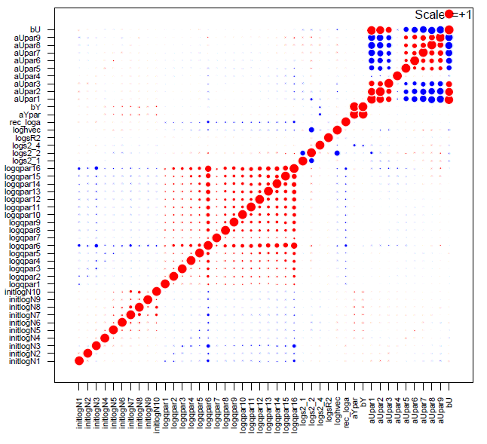
Model fit - correlations

Slide 14
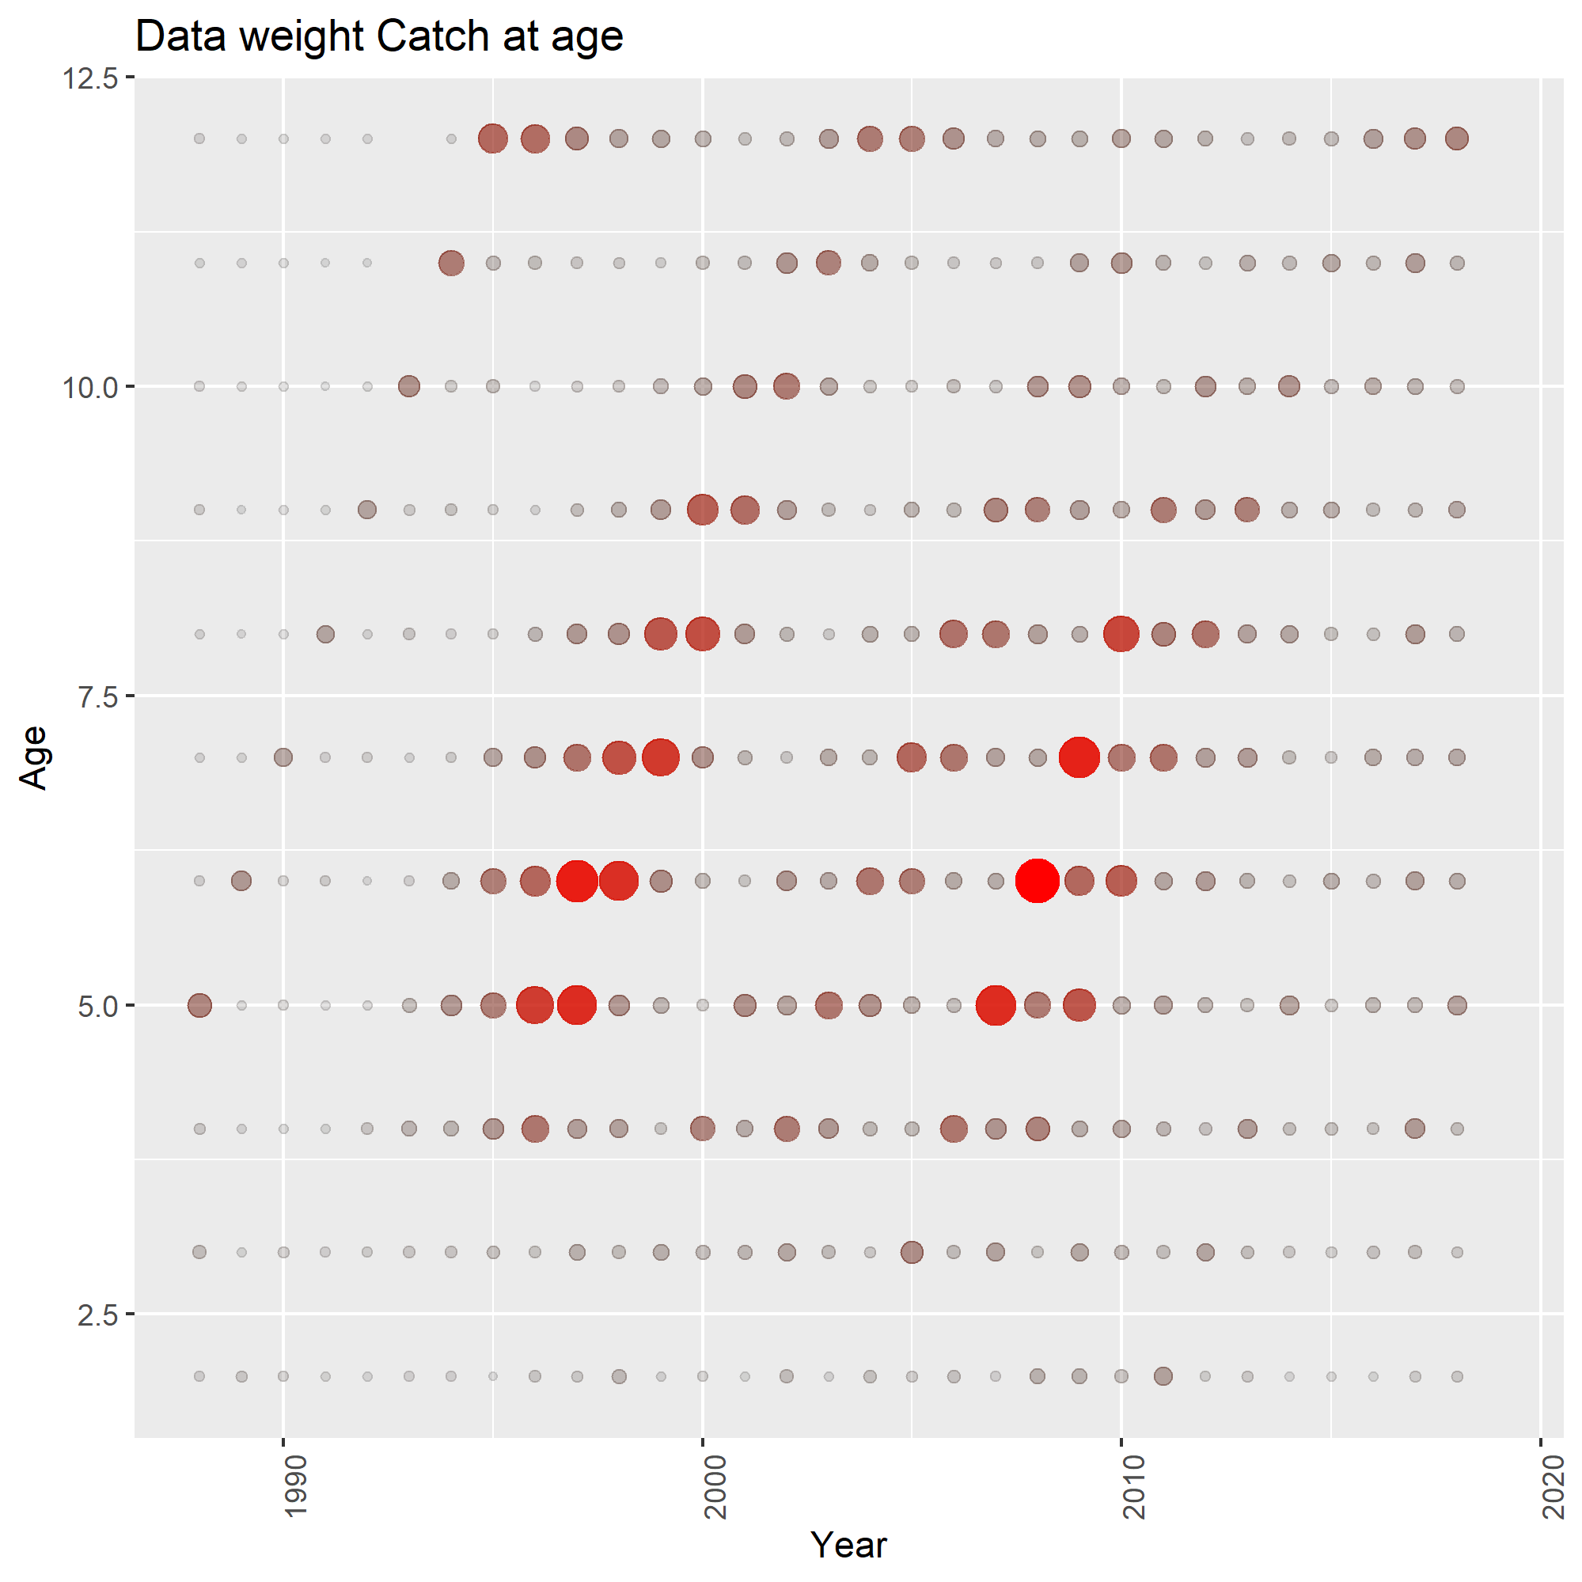
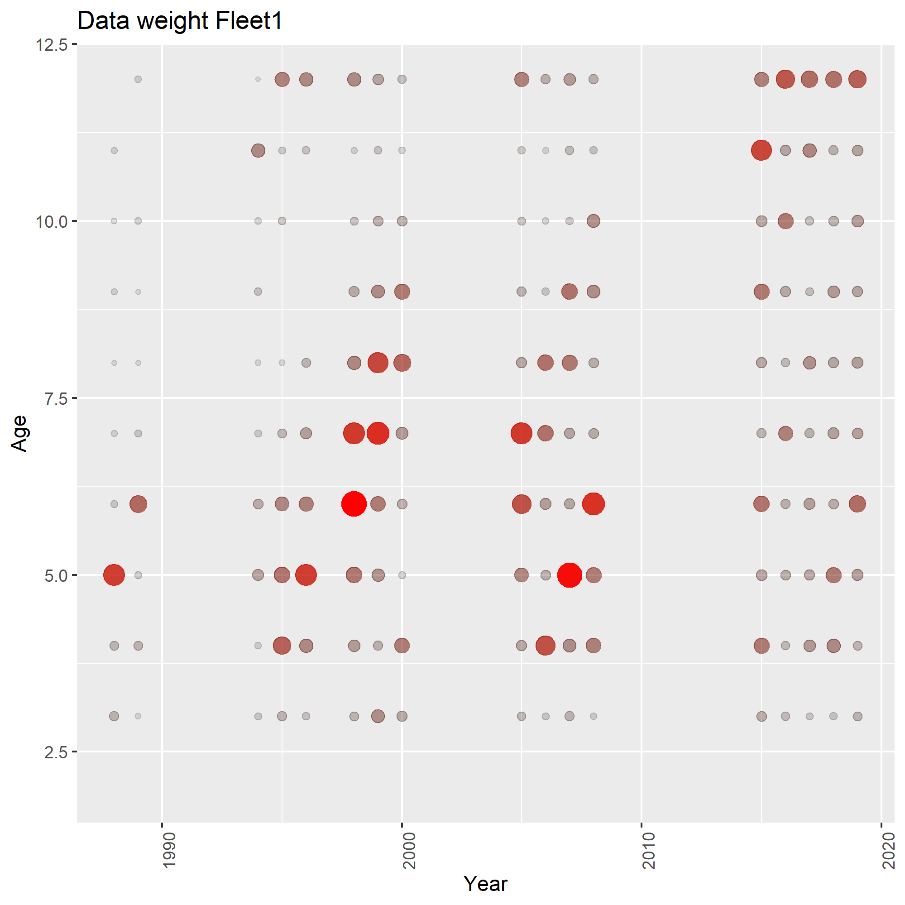
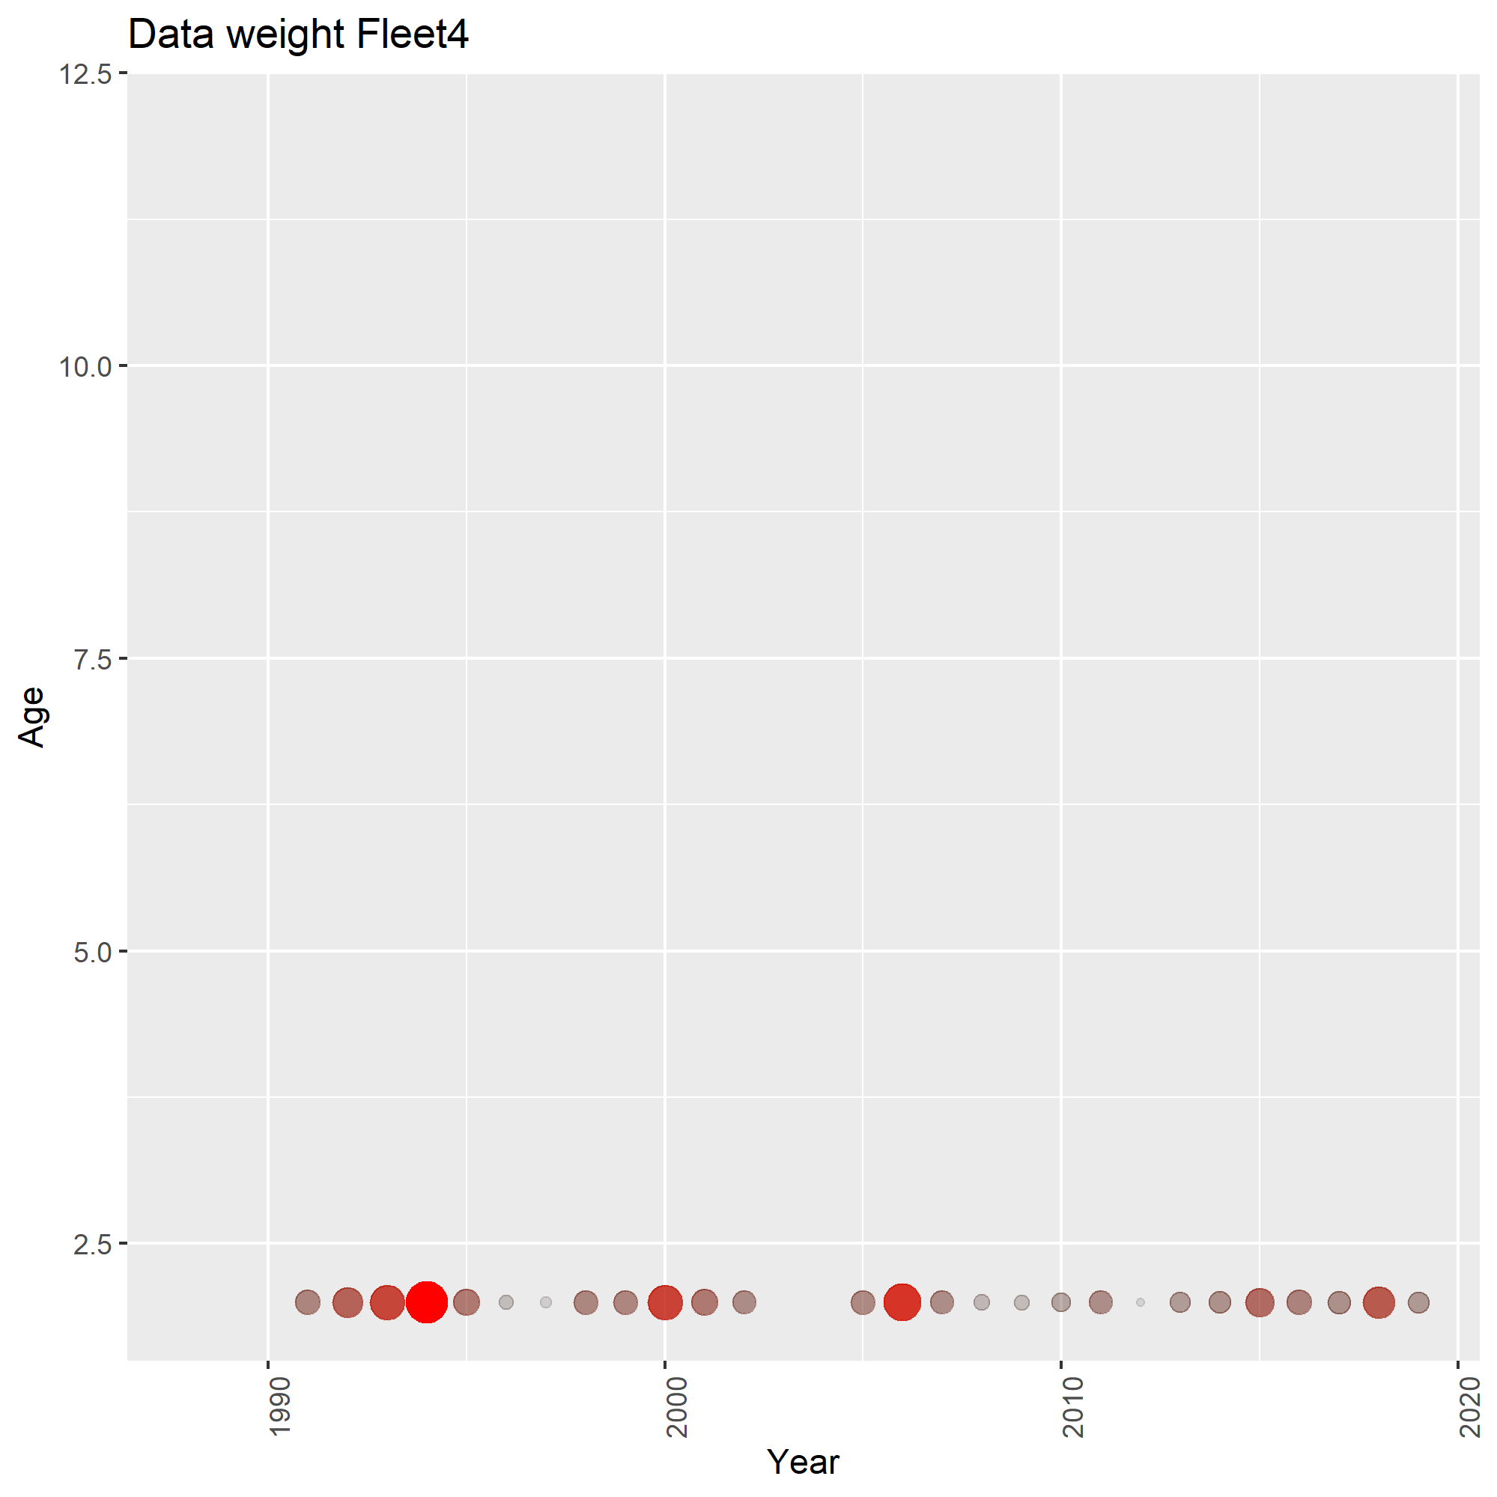
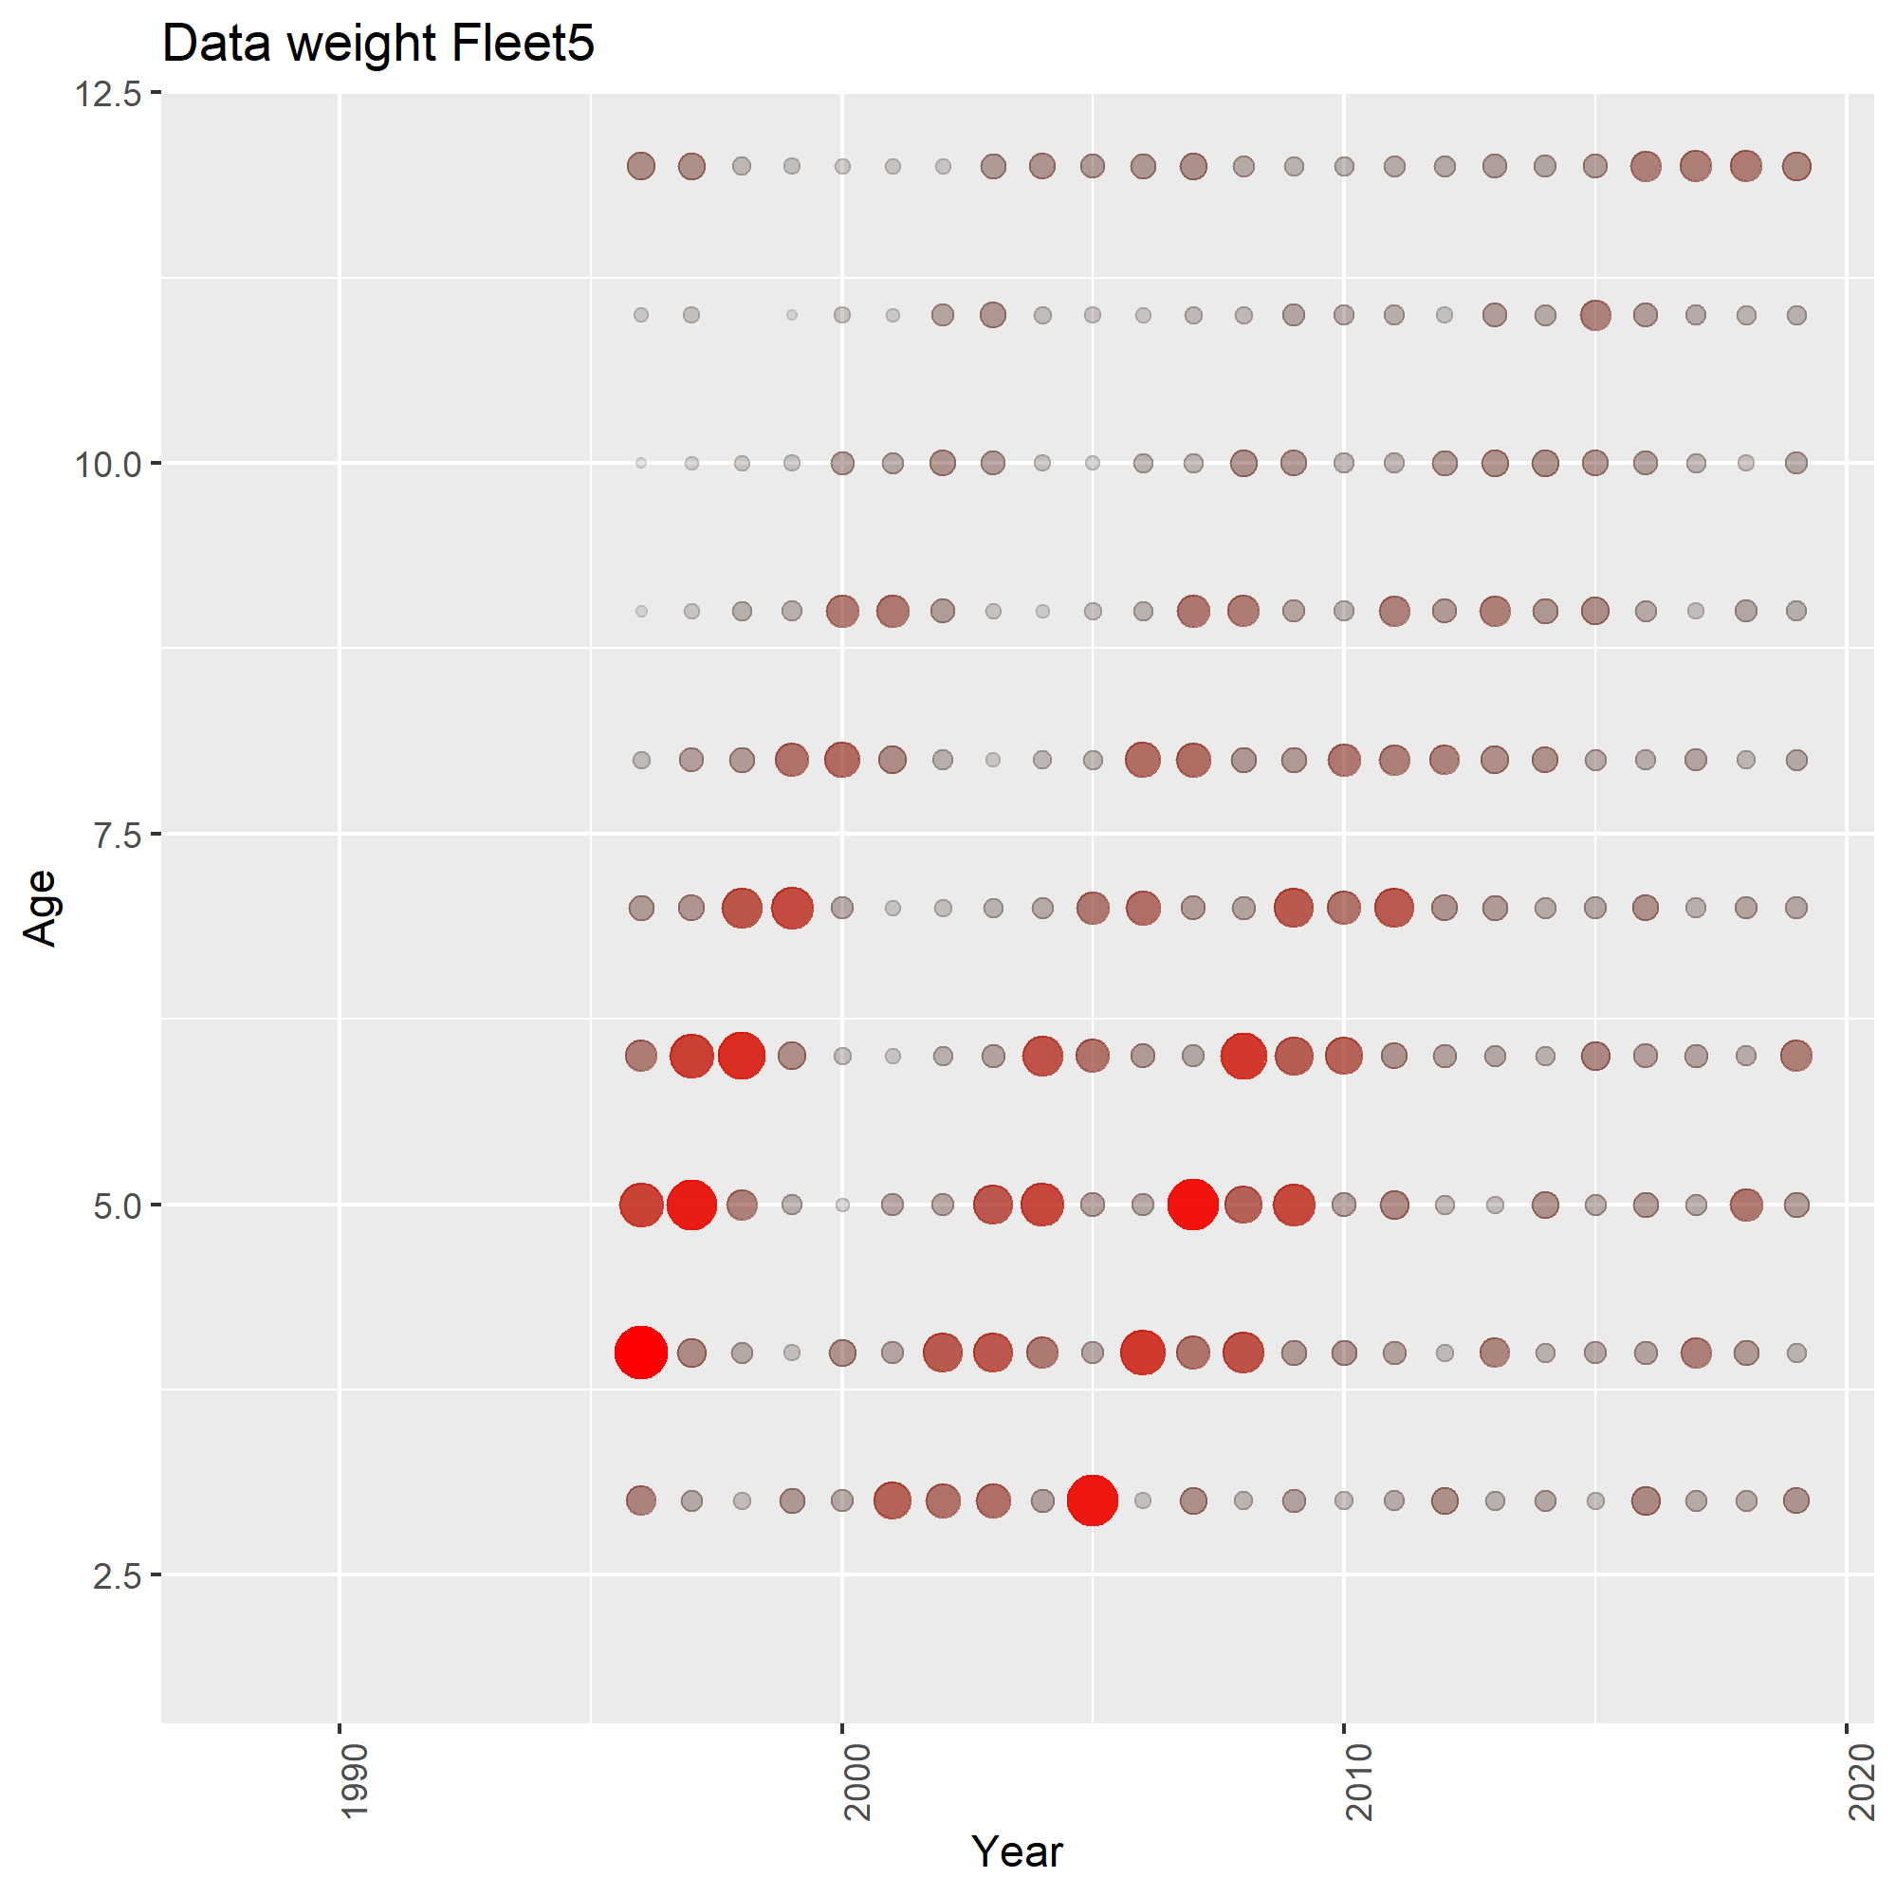
Model fit – Data weights

Slide 15
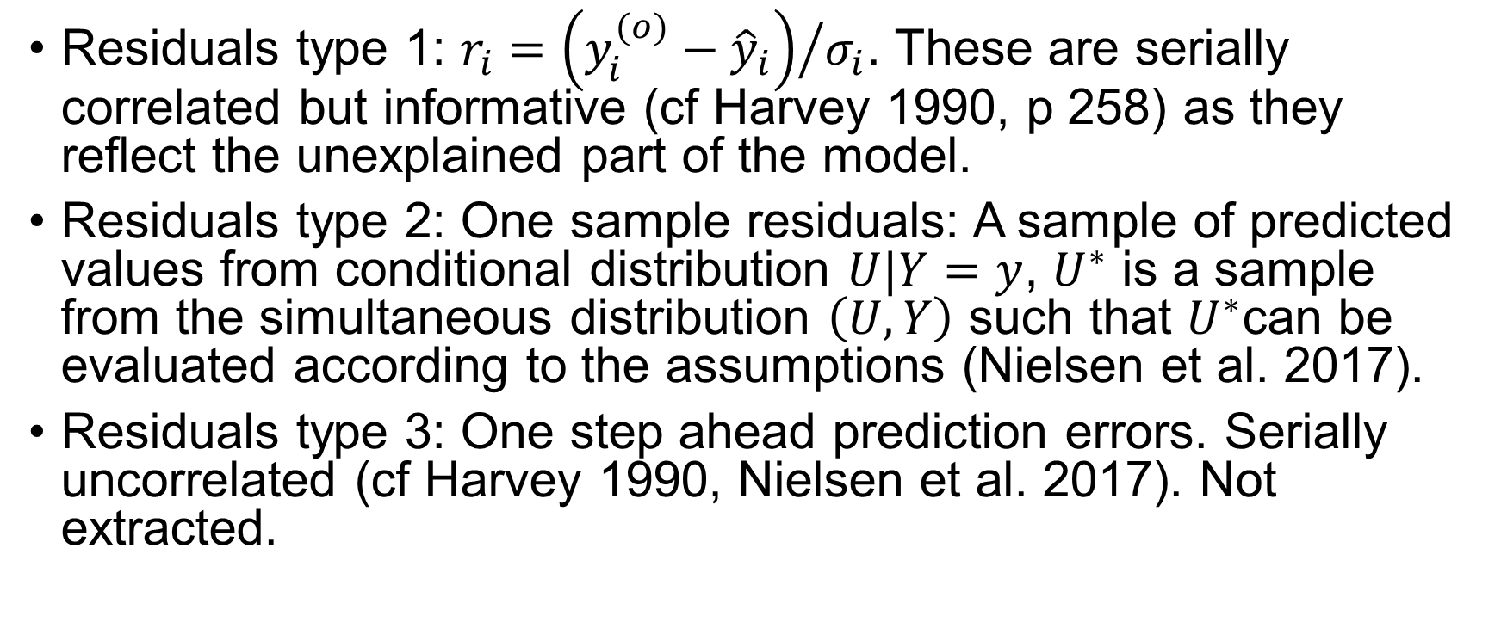
Model fit - residuals
Residuals type 1: $r_{i}={\left(y_{i}^{(o)}−{\hat{y}}_{i}\right)}/{σ_{i}}$. These are serially correlated but informative (cf Harvey 1990, p 258) as they reflect the unexplained part of the model.
Residuals type 2: One sample residuals: A sample of predicted values from conditional distribution $U|Y=y$, $U^{∗}$ is a sample from the simultaneous distribution $\left(U,Y\right)$ such that $U^{∗}$can be evaluated according to the assumptions (Nielsen et al. 2017).
Residuals type 3: One step ahead prediction errors. Serially uncorrelated (cf Harvey 1990, Nielsen et al. 2017). Not extracted.

Slide 16
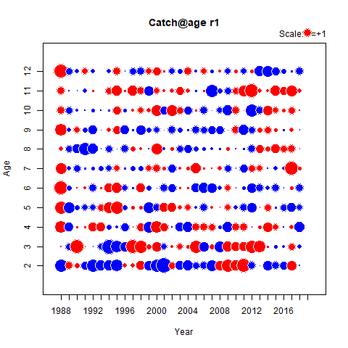
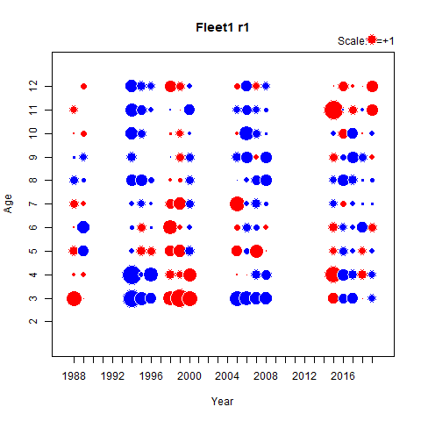
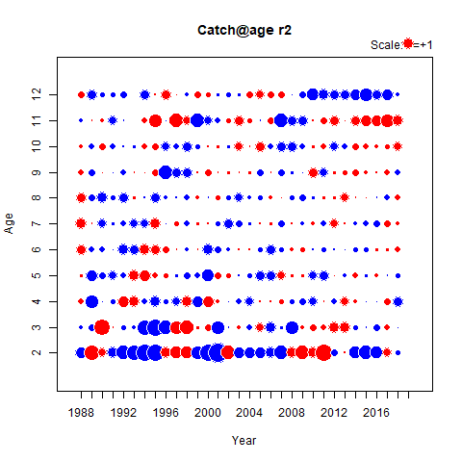
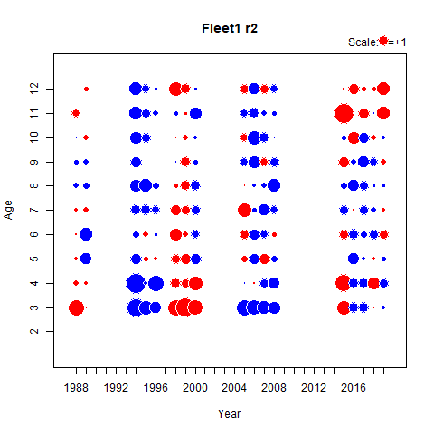
Model fit – residual (catch and fleet 1)

Slide 17
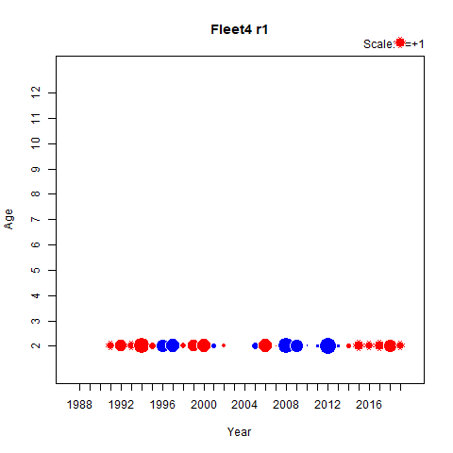
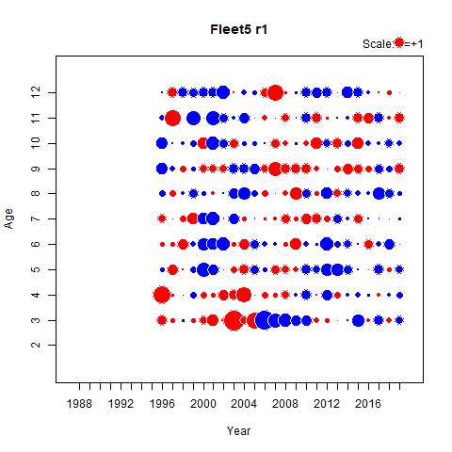
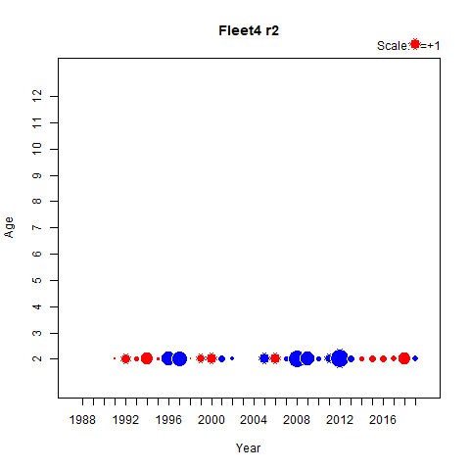
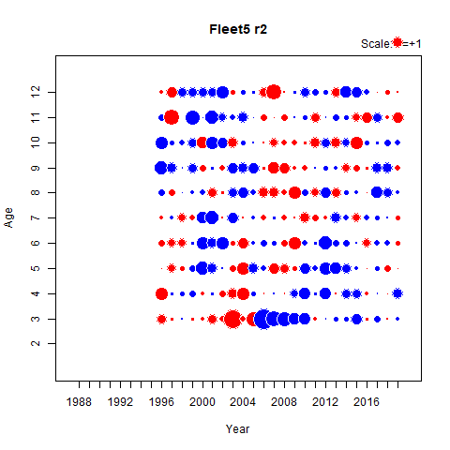
Model fit – residual (fleet 4 and 5)

Slide 18
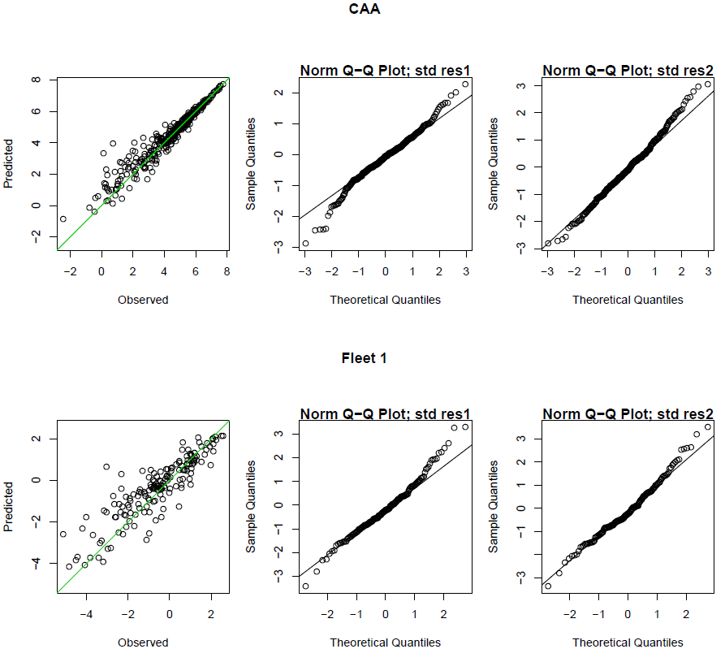
Model fit – QQplot (Catch and fleet 1)

Slide 19
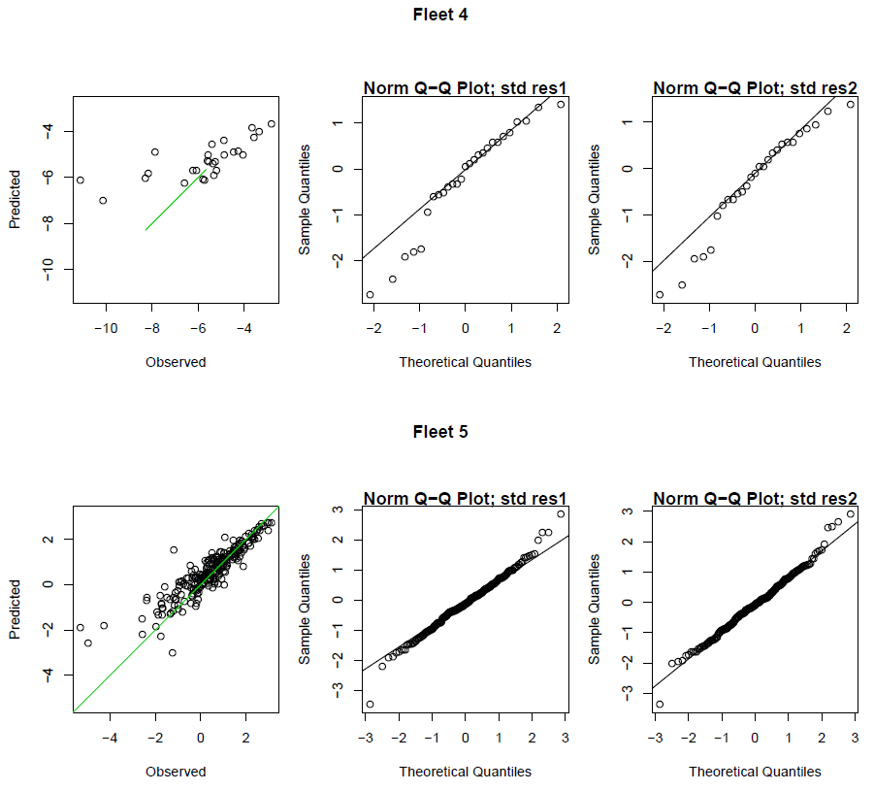
Model fit – QQplot (Fleet 4 and 5)

Slide 20

Model fit – likelihood profiles

Slide 21


Model fit - precision

Slide 22


Model fit – selection pattern

Slide 23


Model fit – 5 year retro

Slide 24

Model fit – signals in data

Slide 25



Model fit – leave out runs

Slide 26



Model fit – stock development

Slide 27


The difference in bootstrap

